Slide 1
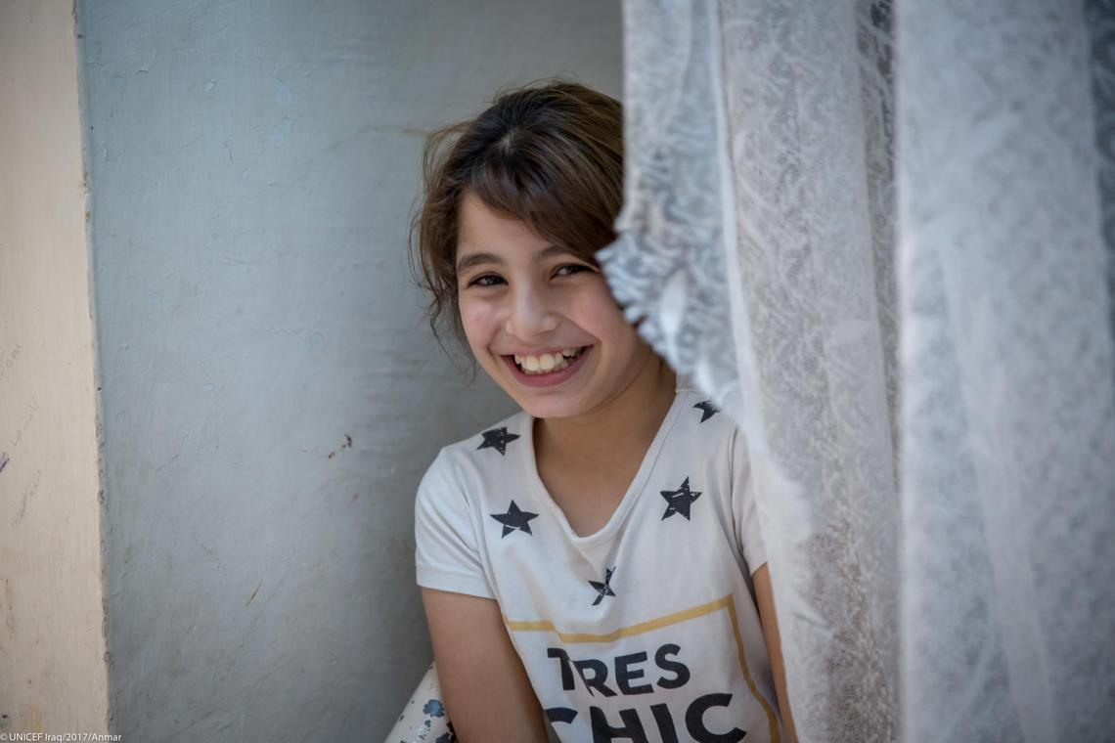
Welcome to the workshop on Violence Prevention!
By the Global Child Protection Area of Responsibility
in partnership with World Vision
Virtual training, 1. – 3.12.2021

Slide 2
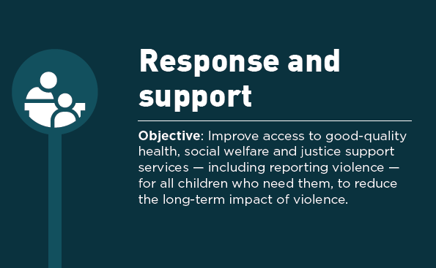

Slide 3
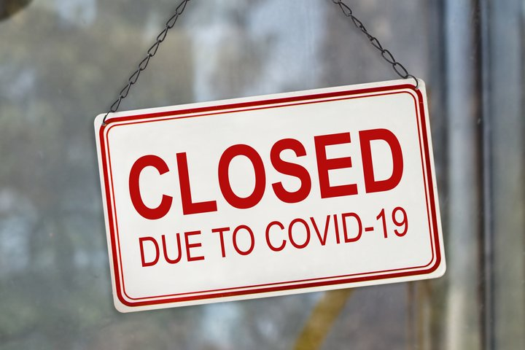
Question
Imagine you as a child: You are sitting since weeks in your house due to COVID-19 lockdowns, no schools, no child clubs, no play with your close friends. You can only leave the house once in a while to support your mama going shopping or other very urgent matters. Beside this you are asked to stay at home.
What are your feelings?
To whom would you reach out to talk to?

Slide 4
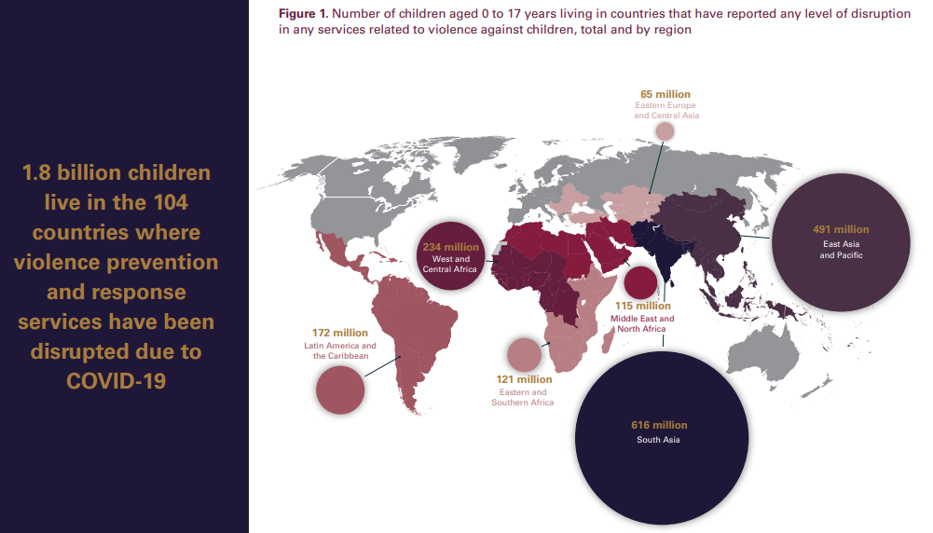

Slide 5
Two Examples
Create a safety plan
A safety plan is a personalized, practical plan to improve your safety while experiencing abuse, preparing to leave an abusive situation, or after you leave. This plan includes vital information tailored to your unique situation and will help you prepare for and respond to different scenarios, including telling your friends and family about your situation, coping with emotions, and various resources suited to your individual circumstances.
Child Helplines
Child Helpline International is a worldwide network of 173 helplines across the world. On their website, you can search for the helpline in your country and call to raise child protection issues with national authorities.

Slide 6
It is important…
… to have a system for helping children
A set of connected things/ programs that operate together.
A set of structures that have a particular purpose

Slide 7
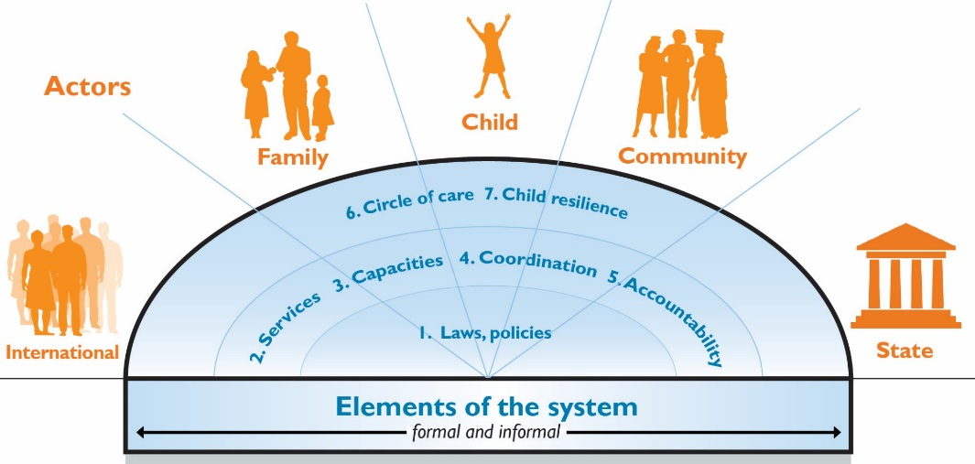
It is important…
… to have a system for helping children
Source: World Vision International

Slide 8
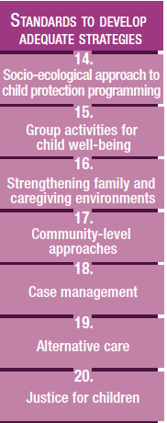
Systems Strengthening in the Child Protection Minimum Standards: Pillar 3
Notes:
For the third session:
Pillar 3 of the CPMS focuses on standards to develop adequate strategies and is structured around the socio-ecological model. The socio-ecological model provides a concrete framework that supports systems thinking for child protection programming. The socio-ecological model helps identify the ways that factors at interconnected levels influence children’s development and well-being. Rather than looking at a single protection issue or specific service in its own, Pillar 3 promotes consideration the full range of problems facing the child, their root causes and the solutions available at all levels. It also links with the the INSPIRE package, where appropriate, and builds on their evidence-based strategies for preventing violence against children.
In humanitarian settings, it is particularly critical to strengthen both formal and informal elements of the child protection system. Standards 15, 16 and 17 focus on children, families and communities and provide key actions and indicators for strengthening the informal elements of CP systems. Standards 18, 19, 20 focus more on the formal elements of the CP systems and provide key preventative and response strategies for strengthening the social welfare and justice systems.
In our experience there as been less guidance and less experience in strengthening the informal system. However, we know in humanitarian contexts that those are particularly critical, both for response and preventing CP risks.
Next slide and we start looking a little bit in more depth on the Standard 14: the socio-ecological model

Slide 9
Standard 14: Socio-ecological Approach to CP Programming
Actions to:
Incorporate a systems approach and address all four levels of the socio-ecological model
Prevent and respond at the society level
CP systems differ by context and change, adapt, evolve over time →
Analysis of CP risks and protective factors,
Mapping of formal and informal system elements; and
Developing a plan to strengthen, scale up, adapt the system
Notes:
This is a new standard in the 2019 edition, it wasn´t included in the previous.
It links with all the INSPIRE strategies so you can see that sort of colourful icon with lots of different lines coming out of it. So it links with them and overall approach of systems strengthening.
There is this strong emphasis on prevention as you can see indicated by that shield icon.
The standards provides actions on two levels:
One is the action to incorporate a systems approach and address all four levels of the socio-ecological model
And the other is to provide key actions to prevent and respond to CP concerns at the society level. When we are talking about society level we are probably talking about things of you automatically think of when addressing a systems approach
Prevent and respond at the society level include : Strengthening laws and policies, Funding for child protection and social welfare, and Birth registration services

Slide 10
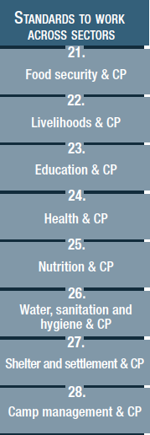
INSPIRE versus CPMS
Multisectoral Approach in the CPMS: Pillar 4
No one sector has the resources or capacities to prevent or respond to all of children’s protection and well-being needs
Health Sector
Justice
Social Services

Slide 11
Health Sector
Address children’s immediate physical and mental health care needs in line with guidelines and protocols
Identification of children that suffer abuse or neglect
Assessing the safety of the child
Interacting with caregivers in suspected cases of child maltreatment
Providing first-line support for children exposed to child maltreatment
Providing basic psychosocial support to victims of child maltreatment and helping with more severe mental health problems
Responding to child sexual abuse
Collecting medical history, conducting physical exams and appropriate documentation of findings
WHO Guidelines for the health sector response to child maltreatment provide evidence-based recommendations:
for frontline health care providers
including in settings with limited resources
to provide immediate and medium-term quality care for children exposed to physical, emotional and sexual abuse and neglect

Slide 12
Justice
Strengthen child-friendly justice processes
Specialist police units
Protective mechanisms where needed
Investigate and prosecute perpetrators
Offer quality, free legal aid
Specialized juvenile justice systems
Diversion and non-custodial sentencing for juveniles

Slide 13
Break-Out
Do laws, policies, mandates, protocols and normative guidance exist to guide the work of service providers in the CP sector?
Think about an example of your country.
Do service providers have sufficient training, supervision and support to implement these effectively?
Notes:
→ break-out rooms

Slide 14
Social Services
Strengthen mechanisms for child protection
Support coordination of services/case management
Offer alternative care, including foster care, if necessary
Counselling and therapeutic approaches
Support treatment programmes for children in juvenile justice system

Slide 15
It is important…
… to find out the children who need help
Raise Awareness
Protect privacy and confidentiality
Establish child-freindly reporting mechanisms
Respond appropriately to children who disclose violence

Slide 16
Child-friendly & gender-sensitive
Child-friendly systems and services recognize children’s right to:
be treated with dignity and compassion;
age-appropriate information they can understand;
be heard and responded to in a non-judgemental way;
timely and convenient access to services and procedures;
choice in how care or service is delivered;
participate actively in decision making processes;
have the opportunity to give informed consent at each step of the care process;
procedures adapted for their age and capacity;
procedures conducted in a child-friendly environment;
have their privacy, confidentiality, integrity, and safety assured.
Child-friendly & gender-sensitive help avoid secondary victimization – harm caused through inadequate response of institutions and individuals to the child.

Slide 17
It is important…
… to help children, immediately and in the longer term
*
* The Alliance for Child Protection in Humanitarian Action has released a Technical Note to support child protection practitioners and government officials in their immediate response to the child protection concerns faced by children who are at risk of separation or in alternative care during COVID-19 pandemic, along with one centred on children in detention centres.

Slide 18
It is important…
… to protect children in conflict with the law
Reduce re-offending
Improve outcomes for children in conflict with the law
Reduce overall crime rates
Use resources for violence response and support more efficiently
Break the cycle of violence!

Slide 19
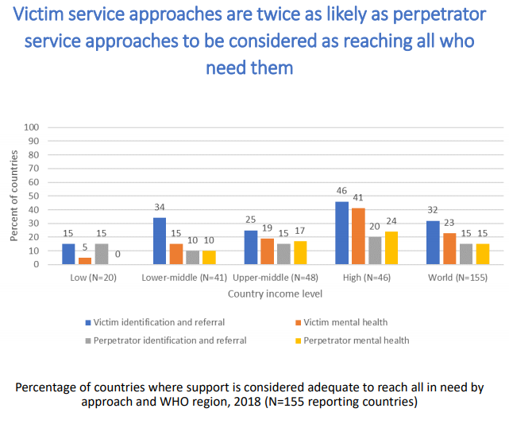
It is important…
… to protect children in conflict with the law

Slide 20
It is important…
… to protect children in conflict with the law
Child Protection Minimum Standard 14:
Preparedness:
Support establishing or strengthening child-friendly courts and spaces in police stations
Support capacity building of personnel within both formal and informal justice systems who regularly come into contact with children. Support inclusion of female officers in law enforcement
Response:
Identify and maintain records on all children in detention: their whereabouts, status, and treatment
Set up an interdisciplinary team of front-line workers to monitor and respond to cases
Advocate for release of children when detention is illegal or facilities are inappropriate

Slide 21
INSPIRE Indicators
Disclosure of lifetime childhood sexual violence
Disclosure of lifetime physical violence in childhood
Help-seeking for lifetime childhood sexual violence
Help-seeking for lifetime physical violence in childhood
Receipt of services for lifetime childhood sexual violence
Receipt of services for lifetime physical violence in childhood
Awareness of support services for violence among adolescents
Support for children in contact with the justice system
Children in detention
Size of the social service workforce
Health sector guidelines on child maltreatment
Health sector guidelines on sexual violence against children

Slide 22
Based on your all reflections throughout this session, …
What services and support are available for children who experience violence?
How do children or their families access services?
What are the gaps?
Notes:
Are these child-friendly? Gender-sensitive?

Slide 23
Key takeaways
Have a system for helping children: Systems thinking brings an holistic analysis of the situation - all different elements and their interaction and interconnectedness
Find out which children need help
Help children immediately and in the longer-term, (including counseling and therapeutic approaches, and foster care interventions involving social welfare services)
Protect children in conflict with the law

Slide 24
Evalution
Please provide your feedback to the training:
Go to https://www.surveymonkey.de/r/7X8M7KP
Notes:
Evaluation to see the learning curve

Slide 25
Resources
Global Partnership to End Violence against Children - INSPIRE: https://www.end-violence.org/inspire
INSPIRE Webinar: https://www.youtube.com/watch?v=BPhza8ED2Qk&feature=youtu.be
Recorded Webinar series to each of the INSPIRE strategies:
https://www.who.int/teams/social-determinants-of-health/violence-prevention/inspire-technical-package
The Alliance for Child Protection in Humanitarian Action - Child Protection Minimum Standards: https://alliancecpha.org/en/CPMS_home
Minimum Standards for Child Protection in Humanitarian Action & INSPIRE strategies:
A guide to complementarity and use in humanitarian action:
https://www.cpaor.net/CPMS_INSPIRE_complementarity_guide

Slide 26
Contacts
Child Protection Area of Responsibility: Verena Bloch (vbloch@unicef.org)
CP AoR Helpdesk:
CPAOR_SpanishHelpDesk@unicef.org
CPAOR_ArabicHelpDesk@unicef.org
CPAOR_EnglishHelpDesk@unicef.org
CPAOR_FrenchHelpDesk@unicef.org
The Alliance in: cpms.wg@alliancecpha.org
INSPIRE WG: http://www.cpcnetwork.org/inspire-working-group/
Notes:
Move to last session

Slide 27
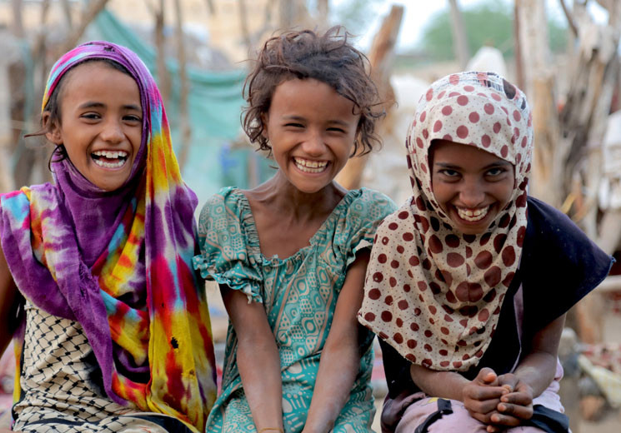
Thank you!

