Slide 1
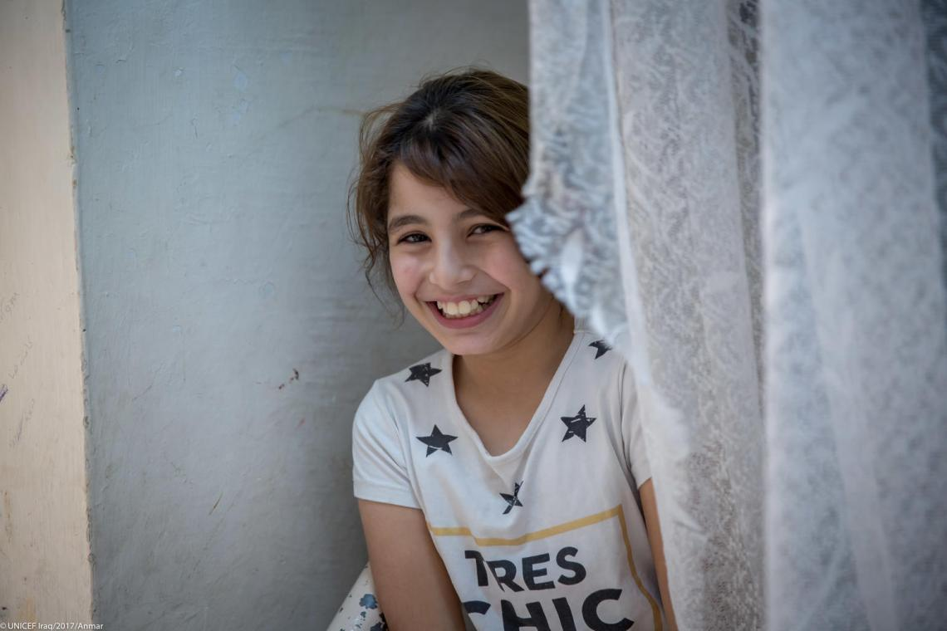



Welcome to the Violence Prevention Workshop!
By the Global Child Protection Area of Responsibility
in partnership with World Vision
Virtual training, 1. – 3. December 2021

Slide 2
Housekeeping Items
Feel free to introduce yourself in the chatbox
Please make sure your name is displaced
Turn off your microphone/ camera while you´re not speaking or presenting
Raise hands if you have any questions and/ or put your questions in the chatbox at any time during the session
Engage in discussions/ activities to share your views and expierences
Materials will be shared after the workshop
The session will not get recorded

Slide 3
Objectives of today
What is a public health approach
Identifying risk and protective factors
Get to know the INSPIRE framework + its supporting documents
Hear about each of the strategies to end violence against children
Complementarity of INSPIRE & CPMS

Slide 4
Violence Prevention –
What is violence prevention for you?
Notes:
To warm up

Slide 5
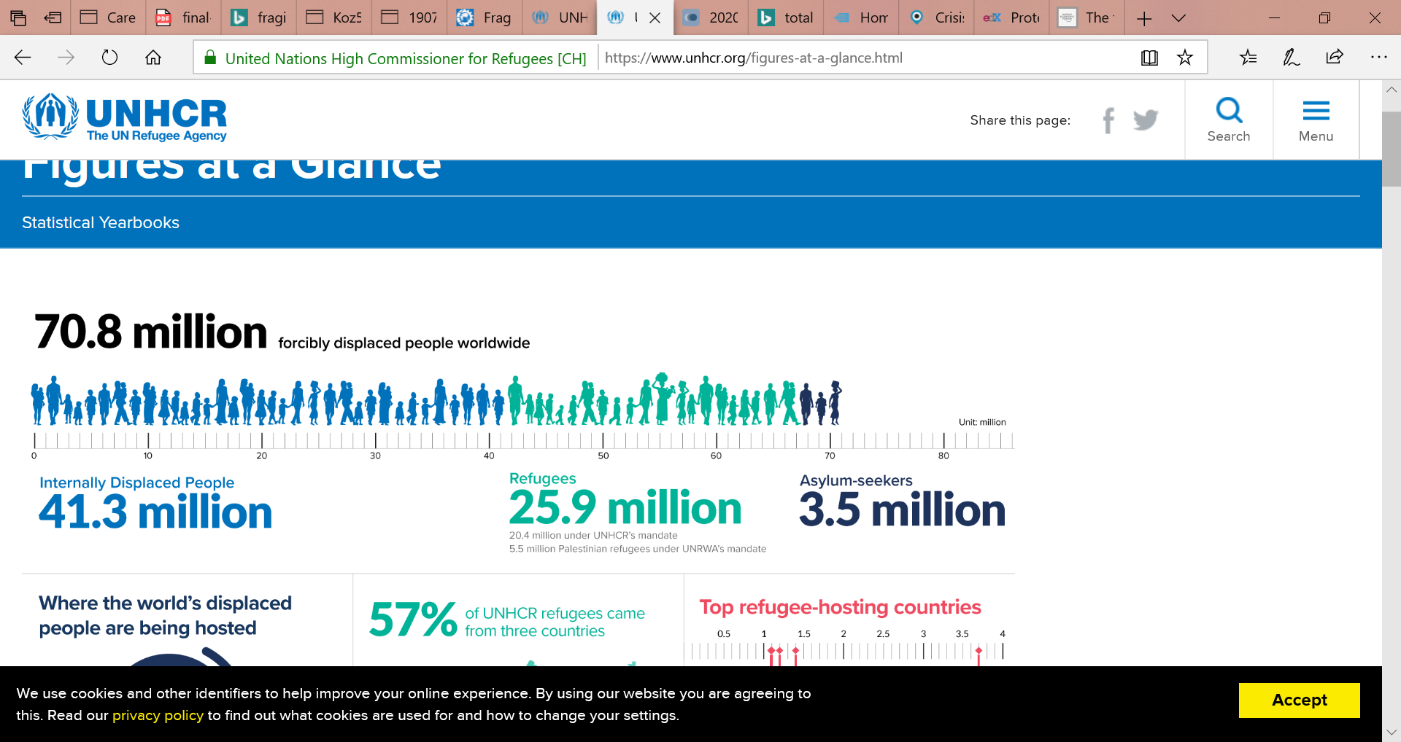
Violence against Children as a public health concern
Globally up to 1 billion children have experienced physical, sexual or psychological violence in the past year.
Over half of total refugees are children. 3.7 million are out of school.
In 2018, over 20 million IDPs worldwide (conflict and violence) were women/girls.
1 in 2 children experience VAC. 1 in 4 children live in a country affected by conflict or disaster.
Many trigger for displacement, including effects of climate change, conflicts, gang violence (e.g. El Salvador, Honduras, Guatemala) and VAC/VAW.
Displaced and migrant children are at higher risk of experiencing VAC.
Pandemic/disease outbreak increase the risks and vulnerabilities of children to VAC.
Notes:
An analysis of nationally representative survey data on the prevalence of violence against children in 96 countries estimates that 1 billion children globally – over half of all children aged 2–17 years – have experienced emotional, physical or sexual violence in the past year. Despite its high prevalence, violence against children is often hidden, unseen or under-reported. Its hidden nature is well documented – for example, a meta-analysis of global data finds self-reported child sexual abuse 30 times higher and physical abuse 75 times higher than official reports would suggest
Nearly 50 million children had been uprooted from their homes due to violence, poverty or natural disasters (2018, source: UNICEF). Such children are more likely to experience one or several forms of violence, ranging from death, injury, sexual and gender-based violence, recruitment and use by armed forces and groups, online violence to long term trauma and deprivation of access to basic services. Prolonged exposure to violence, abuse and traumatic events is likely to impair children’s emotional and social development with devastating long-term impact on children and societies.
Girls are particularly vulnerable to sexual violence. For example, the lifetime prevalence of childhood sexual abuse is 18% for girls, compared to 8% for boys. Girls are also more likely to experience intimate partner violence; rape; child or early/forced marriage; trafficking for the purposes of sexual exploitation and child labour, and genital mutilation/cutting. Such violence occurs in many settings, including those where girls should be safe and nurtured — at home; travelling to, from and within school; in their communities; and in situations of humanitarian emergency, displacement, or post-conflict settings. Boys are more likely to be both victims and perpetrators of homicide, which commonly involves weapons such as firearms and knives.
These are just some examples of the scope of violence. A pandemic as we are experiencing it now increased the scope of violence.

Slide 6

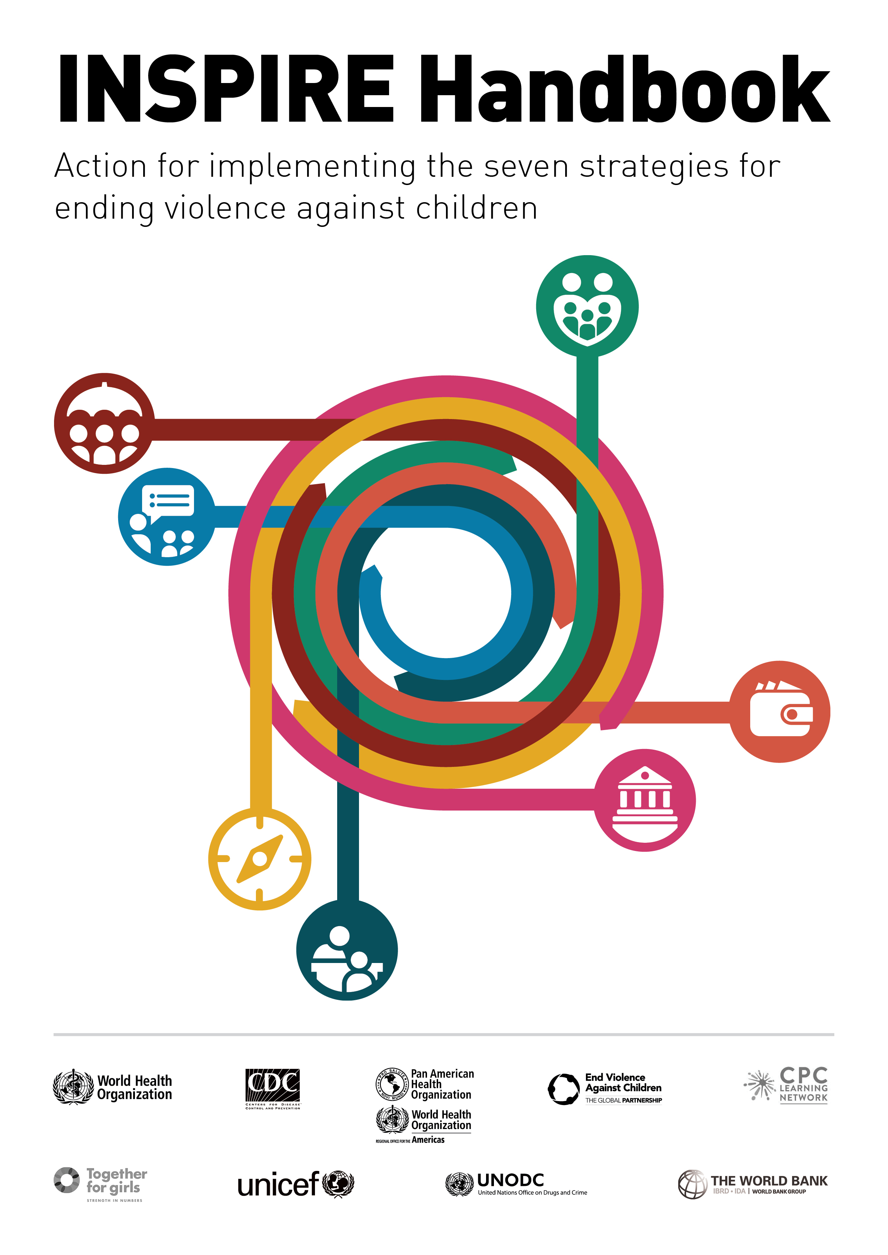
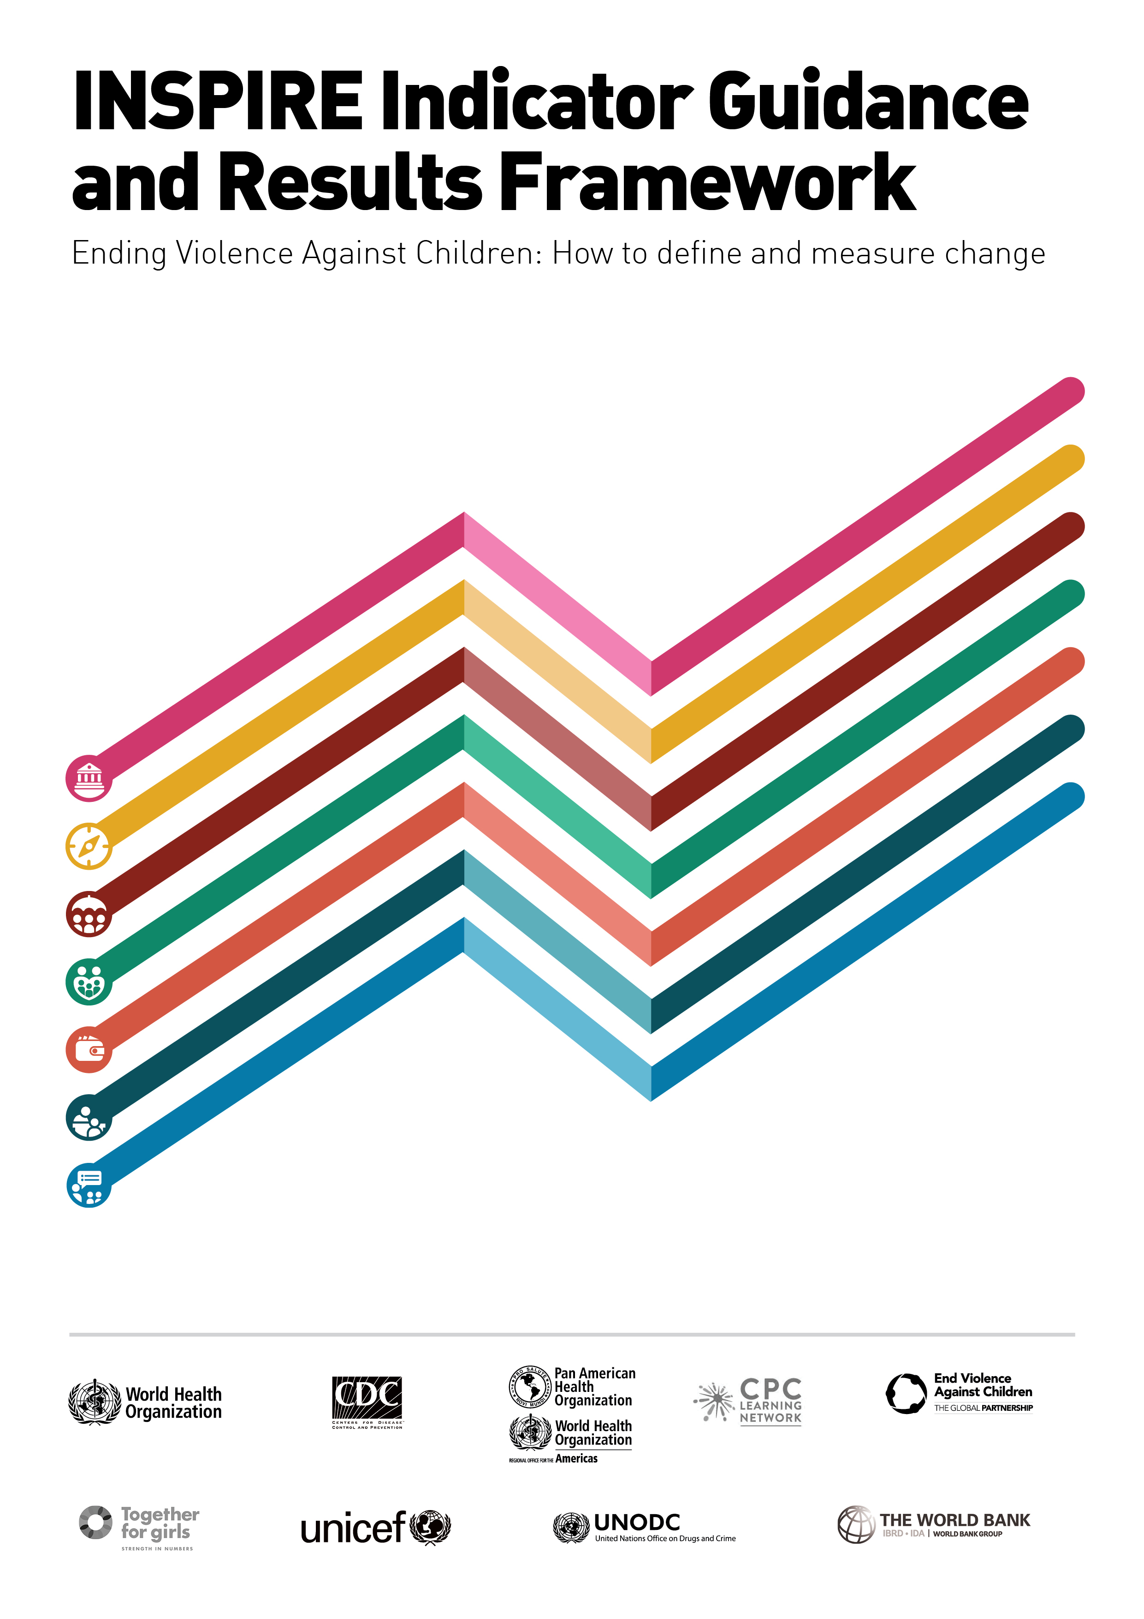
INSPIRE – Technical Package
Seven Strategies for Ending Violence Against Children
Notes:
Working on prevention we are looking at the INSPIRE framework.
INSPIRE is an evidenced-based technical package which got developed by 10 agencies to support governments and those working on preventing and ending violence against children to achieve SDG Target 16.2.
The core document was issued in 2016 while the Handbook and Indicator guidance and results framework were launched in 2018.
The Vision for INSPIRE is that Governments, with the strong participation of civil society and communities, routinely implement and monitor multi sectoral evidence-based interventions to prevent and respond to violence against children and help them reach their full potential

Slide 7
A public health approach
What distinguishes a public health approach?
Focus on prevention
  By identifying risk factors and trying to generate programs that occur before harms occur, a public health approach helps us to rationalize resources and to avoid violence that should be avoided anyone
Focus on programs that are evidence-based, using rigorous methods
  Programs may still require adaptation to local contexts, but experimental research designs have demonstrated that the core components of programs are effective in prevention and reducing violence against children
Use of a life-course analysis
Notes:
Since violence against children is seen as a public health concern, the response to it which is preventing violence against children is addressed by a public health approach. And I want to point out 3 elements of a public health approach:
First of all it focuses on prevention and we will dig into this in a minute. But this is not an approach which prioritizes responding to violence, after violence has already happened. Importantly, the prevention framework does include response and I will explain how that fits together. But the idea is that you identify the risks before harm does happen and you stop it.
Evidence-based, we will also talk about that and what it means to be evidence-based. However, I want to point out that throughout the three session I will mention a number of approaches and tools. All of them are evidence-based and proven to be successful. I only picked approaches like that. However, I will not focus on the methods and data of the evidence in this workshop, rather looking on what can be done and how to do it.
A third element is that a public health approach uses a life-course or a life-cycle analysis. Focusing on prevention in childhood to prevent so many problems later in life. Violence against children can have short- and long-term consequences. I am not gonna go into detail of the consequences. But they are well describe in the INSPIRE documents. However, they are rather medical than how we think from a child protection perspective such as maternal and child health problems.

Slide 8
Prevention Pyramid of a Public Health Approach
Think of an example of a prevention program you have been involved with. Which level or levels of prevention did it address?
Tertiary
Secondary
Primary
Tertiary prevention or response
Supports survivors and holds perpetrators to account
(and aims to prevent the reoccurence of violence)
Help is here
Secondary prevention or early interventions
Aims to `change the trajectory`for individuals at higher than average risk of perpetrating or experiencing violence
Get in early
Primary prevention
Whole of population initiatives that address the primary (´first or underlying) drivers of violence
Stop it before it starts
Notes:
This is a prevention pyramid that a public health approach would use. There are a few different versions of it, but this is the one most appropriate for INSPIRE.
Looking at the top, tertiary prevention actually is Response. This is were you are providing supportive interventions, and also holding perpetrators to account to prevent the reoccurrence of violence. So even response is a preventive measure. “Help is here” is the top tertiary level of prevention. Reduces the longer-term impact of harm and reduces the chance of recurring harm. This can be for instance case management services or Reintegration support for children associated with armed forces and armed groups.
The secondary level is where you are identifying children and families who are at higher than average risk of experiencing violence and intervening so that you can hopefully change the outcome before it happens. These are probably more targeted interventions and probably more universal. The core concept here is that you are getting in early, seeing when things are going wrong, using a risk factor analysis to figure out which children and families would benefit from that. Addresses this specific threat and/ or vulnerabilities of a child identifies as being at high risk of harm. Examples can be Life-skills sessions for out-of-school adolescents at risk of recruitment in armed groups and child labor OR targeted financial support to families where child marriage is identified as a risk
Finally, primary prevention is for the whole of population. You just want to stop before it even starts. It is looking at a number of factors that any child or any family should know about and receiving information. It addresses the root causes among the population to reduce the likelihood of harmful outcomes. Investing in primary prevention reduces risk and increases protection within the population or community, leading to an overall reduction in the number of families and children in need of secondary and tertiary prevention and response services.
That could be for example, policies that strengthen household financial security or community-wide access to parenting support services
Prevention approaches may reduce, but will never eliminate, the need for responsive services. Experience in non-humanitarian contexts has shown that an initial shift to primary prevention approaches may increase the need for response services, as awareness of child protection issues in a community grows.
Primary prevention and response programming are complementary and essential components of child protection systems. Interventions to strengthen child protection systems -- investing more in the social service workforce -- will support both prevention and response approaches.
Question: Think of an example of prevention program you have been involved with. Which level or levels of prevention did it address?
Type it in the chatbox or feel free to unmute yourself to share your example.

Slide 9
Evidence-based practices – what does it mean?
Evidence-based practices in INSPIRE means…
They have been scientifically evaluated
They are found to be effective
They are based upon the best available research evidence, rather than personal belief or anecdotal evidence
Interventions can be evaluated and shown to be ineffective. These are not evidence-based practice.
INSPIRE also includes some prudent practices which global treaties or resolutions have determined are critical to reducing violence, and/or are shown by observational or qualitative studies to be effective in reducing violence.
Notes:
A public health approach focus on programs that are evidence-based: INSPIRE reflects the best available evidence of effective, prudent and promising practice.
They have been scientifically evaluated. That means that they are based upon the best available research evidence, rather than personal belief or anecdotal evidence
They are found to be effective. You need to consider that interventions can be evaluated and shown to be ineffective. These are not evidence-based practice.
Programs may still require adaptation to local contexts, but experimental research designs have demonstrated that the core components of programs are effective in prevention and reducing violence against children. The ToC therefore and core elements need to be maintained to ensure desired impact. All other elements would need to be adapted to the participants, the culture and the context to contribute to the success of the intervention. Implementers need to find the right balance between fidelity to original evidence-based programmes and adaptation to new circumstances.
Evidence is: Baseline and Endline and Control trials
There are many challenges to generating “evidence” in the social science sense in humanitarian settings. Can you think of some?
Humanitarian emergencies are, in some ways intrinsically, responsive. Many external changes can be happening simultaneously. The clean careful design of a research study may not be feasable or ethical.
Populations can continue to move and to migrate. Staying in touch with the same research participants over time can be a challenge.
It can be unethical to see to create “control groups” when a population has extreme needs. Researchers must be very careful to ensure that they are truly filling learning gaps.
Despite the challenges, rigorous impact evaluations do happen in humanitarian settings.

Slide 10






Life-course Analysis
<5 years old
5-10 years old
11-17 years old
18+ years old
Notes:
Another element of a public health approach they are automatically using a life cycle analysis to disaggregate data. Looking at types of violence against children you are seeing that different forms of violence like maltreatment, bullying, youth violence are at different stages of childhood.

Slide 11
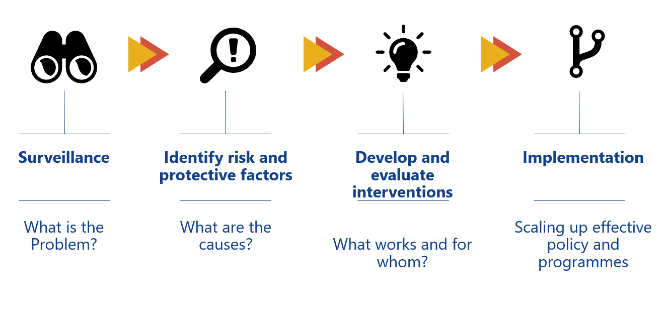
INSPIRE – clear logic model
Notes:
The logic model that underlies INSPIRE, and has four steps again used from a Public Health Approach:
Analyzing and monitoring – What is the nature and scale of the problem? This is to define the problem in statistical terms that tell us about the who, what, when, where and how of violence against children;
You might think that this is normal. But it is not for the topic of violence. For birth registration every country would have numbers. For violence against children the INSPIRE framework is a first tool to build up the monitoring and surveillance in that.
Identify risk and protective factors – along with the causes of violence → Important not focused on needs! But the idea is that you identify the risks before harm does happen.
Based on this we develop programmes that can effectively address the causes,
Implement and scale up effective policy and programmes. And also scaling up policies and programmes, so that you reach the population at scale.

Slide 12
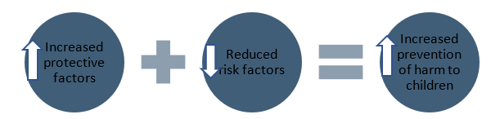
Risk & Protective Factors
It goes beyond the question of “What are the harmful outcomes to children occurring in this context?” (e.g., child marriage, violence in schools, recruitment in armed forces, family separation). Prevention programming must also ask:
“What are the risk factors leading to harmful outcomes for children that can be reduced?”
and
“What are the protective factors preventing children from experiencing harmful outcomes that can be strengthened?”

Slide 13
Risk & Protective Factors
Risk factors are threats and vulnerabilities that increase the probability of a negative outcome.
Threats exist in a child's environment, such as individuals or groups who are abusing children or events.
Vulnerabilities are individual traits or experiences that make a person or group susceptible to a threat (e.g., gender, ethnicity, being out-of-school, etc.).
Think about the negative outcome of home-based violence in South Sudan:
What are the risk factors leading to home-based violence against children that can be reduced?

Slide 14
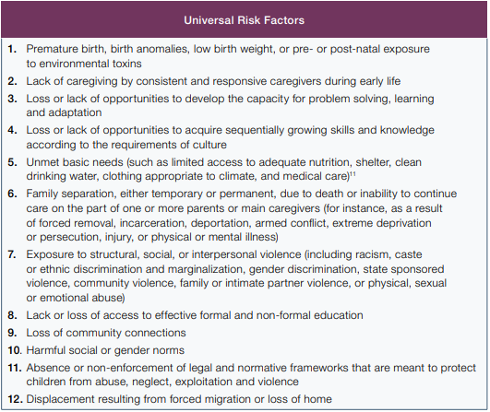
Risk & Protective Factors

Slide 15
Risk & Protective Factors
What are the protective factors in your context preventing children from experiencing home-based violence that can be strengthened?
Protective factors balance and buffer risk factors and reduce a child’s vulnerability. They lower the probability of a harmful outcome. This includes capacities to mitigate threats (e.g., having a supportive peer group or enforcement of laws to ensure children are not engaged in harmful work).

Slide 16
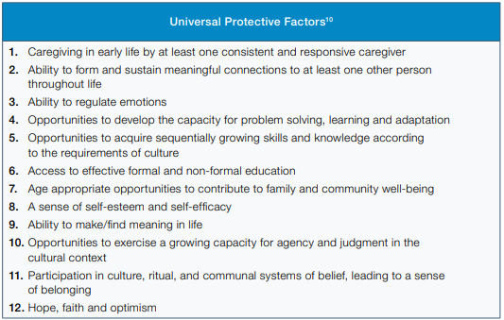
Risk & Protective Factors

Slide 17
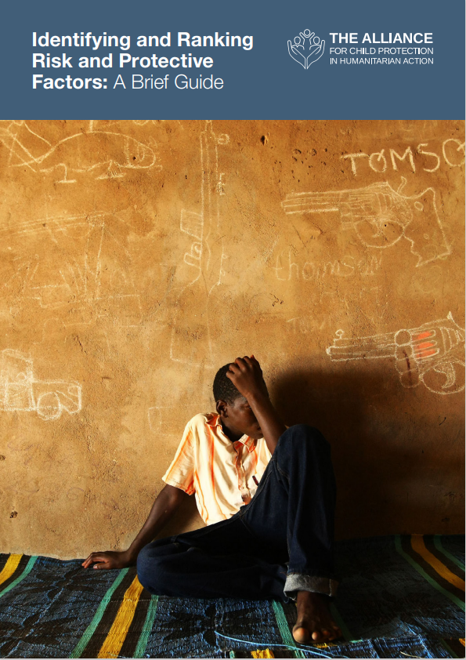
Risk&Protective Factor Identification
Participatory assessment exercises with children, families, and community members such as focus group discussions or surveys.
Why is identifying and ranking risk and protective factors important and necessary?
Who can use this methodology to identify and prioritize risk and protective factors?
When should you identify risk and protective factors?
identifying_risk_and_protective_factors_a_brief_guide.pdf (alliancecpha.org)
Notes:
identifying_risk_and_protective_factors_a_brief_guide.pdf (alliancecpha.org)

Slide 18

Stretching
5 minutes

Slide 19
INSPIRE
Seven Strategies for Ending Violence Against Children
Notes:
Each letter of ‘INSPIRE’ stands for one of the strategies, namely: Implementation and enforcement of laws; Norms and values; Safe environments; Parent and caregiver support; Income and economic strengthening; Response and support services; and Education and life skills.
Each of the intervention featured in the INSPIRE Handbook contains core elements, including the theory of change and evidence-based interventions. It also includes estimated costs and links to existing resources and tools.
It is important to understand that the INSPIRE framework is not a framework for the CP sector alone. The indicated evidence-based approaches come from all kind of sectors, addressing different actors along the socio-ecological model and age groups of children.

Slide 20

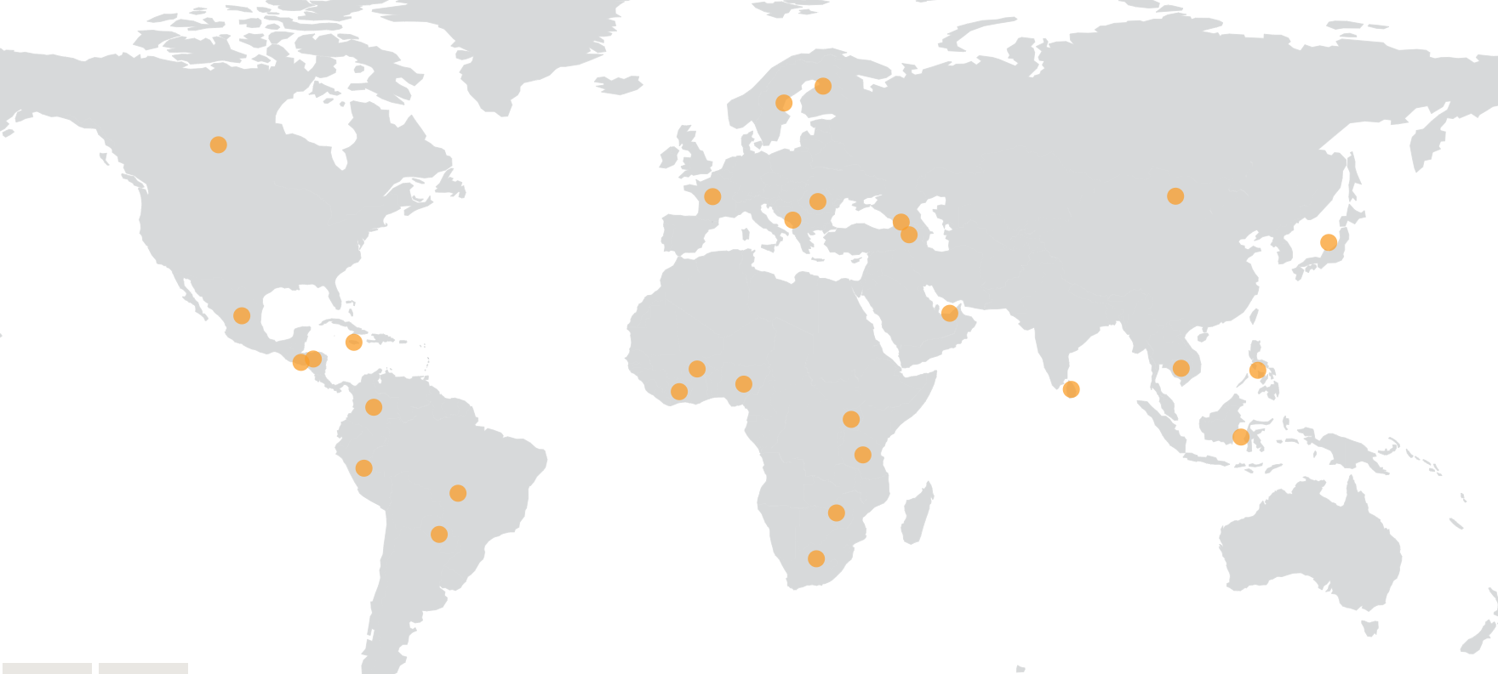
Pathfinding countries
Armenia
Brazil
Burkina Faso
Colombia
Cambodia
Canada
Cote d'Ivoire
El Salvador
Finland
France
Georgia
Honduras
Indonesia
Jamaica
Japan
Mexico
Mongolia
Montenegro
Nigeria
Paraguay
Peru
Philippines​
Romania​
South Africa​
Sri Lanka​
Sweden​
Tanzania​
Uganda​
United Arab Emirates
Zimbabwe
Notes:
You might have seen this logo before. If we talk about INSPIRE I need to quickly refer to the Global Partnership to End Violence against Children.
The Global Partnership and Fund to End Violence Against Children were launched in July 2016 by the UN Secretary-General. The Partnership is the only global entity focused solely on Sustainable Development Goal 16.2: ending all forms of violence against children by 2030.
The End Violence Partnership is a platform for collective, evidence-based advocacy and action. Working with a unique coalition of more than 600 organisations including governments, UN agencies, research institutions, international NGOs, foundations, local CSOs, private sector groups and faith networks.
End Violence supports actions that provide support to those working to prevent and respond to violence, protect childhood and make societies safe for children
End Violence works with partners across sectors to build political will, promote solutions, accelerate action and strengthen collaboration.
What is the relationship between the Global Partnership to End Violence against children and INSPIRE?
The Global Partnership to End Violence against children contributed to the development of the INSPIRE package and is promoting its use to accelerate action to end and prevent violence in countries and communities.
Since its launch in 2016, End Violence successfully promoted the concept of Pathfinding countries, whereby governments make a public commitment to do more to end violence against children, establish a multi-sectoral platform, develop a national action plan based on evidence and adopt INSPIRE strategies. If governments commit to work on ending violence they will be asked to really work with the INSPIRE framework due to its evidence-based character.
At the beginning there were like 6 countries who were very committed to end violence against children and who decided to join the partnership. Today they have 31 countries and it keeps growing. Among those countries you also have humanitarian settings for instance Nigeria.

Slide 21






INSPIRE – Implementation Handbook
How to choose and implement interventions suited to your context, including:
Appropriate populations and settings
Core intervention components
Costs and cost-effectiveness
Human resource and infrastructure requirements;
Where to get manuals, training programmes and other implementation support
Lessons learned from previous implementation efforts
Notes:
The handbook is the major guide to the strategies.
The Handbook and the Indicator guidance really do try to use a user experience model to help you think about whether or not interventions would be appropriate for your setting or population. The handbook has very clear summaries of pieces of the interventions that should be included.
The handbook’s seven strategy chapters focus on helping users to choose between the different interventions based on their fit with existing resources. To this end it explores the following questions:
What can I and what should I do in my context?
How would I do it in my context?
What will it cost? So basic considerations on costing and cost-effectiveness
What are the human resources required? The human resource and infrastructure requirements. So descriptions of how many facilitators per person you would need and things like that
Where can I get more information? Where to get the other manuals, training programmes and support
How will I know it’s working? Any lessons-learnt. So the people who developed that handbook they called up all of the implementers who have used INSPIRE approaches and talked to them to know what worked and what didn´t work. It is important to learn from “failure”!

Slide 22
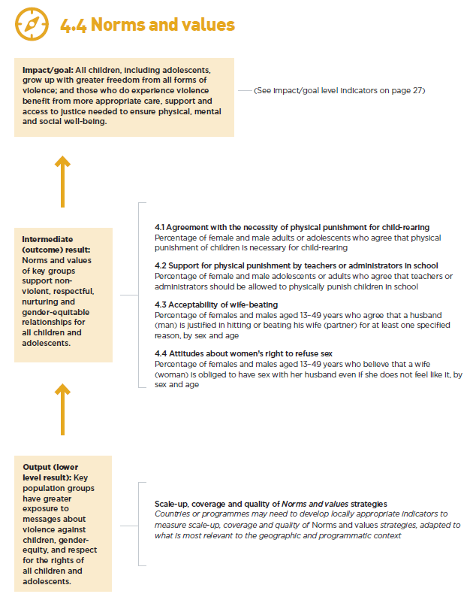
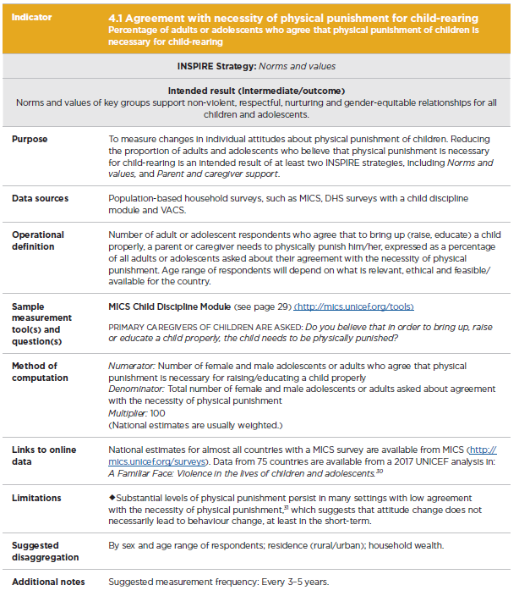
INSPIRE – Indicator & Results Framework
Notes:
The Indicator Guidance and Results Framework is designed to help governments and non-governmental organizations monitor progress and track change over time as they implement INSPIRE strategies. This publication includes a set of core indicators and detailed guidance on how to define and measure these indicators to monitor changes across sites and over time, as well as a results framework. INSPIRE partner agencies developed these results and indicators through a collaborative process led by UNICEF. They complement and are intended to be used side-by-side with detailed programming guidance for each strategy provided in the INSPIRE Handbook.
→ Example from Strategy Norms and Values

Slide 23
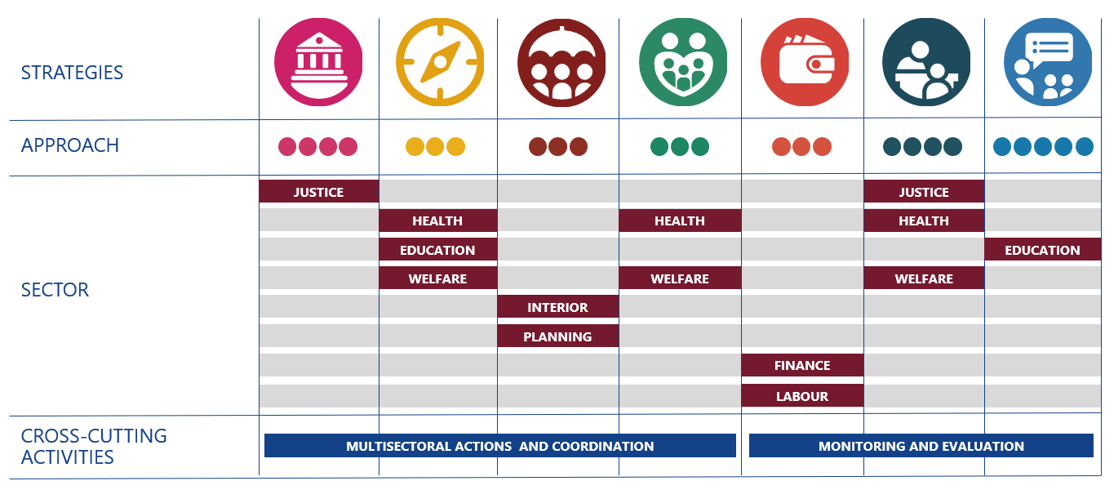
INSPIRE
Components

Slide 24
Quiz
Which Strategy does the following approaches belong to?

Slide 25
Quiz – The Approaches
Approach: Laws banning violent punishment of children by parents, teachers or other caregivers
Safe Environments
Implementation and Enforcement of laws
Parent and Caregiver Support
Education and Life Skills
Response and Support Services

Slide 26
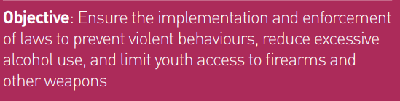
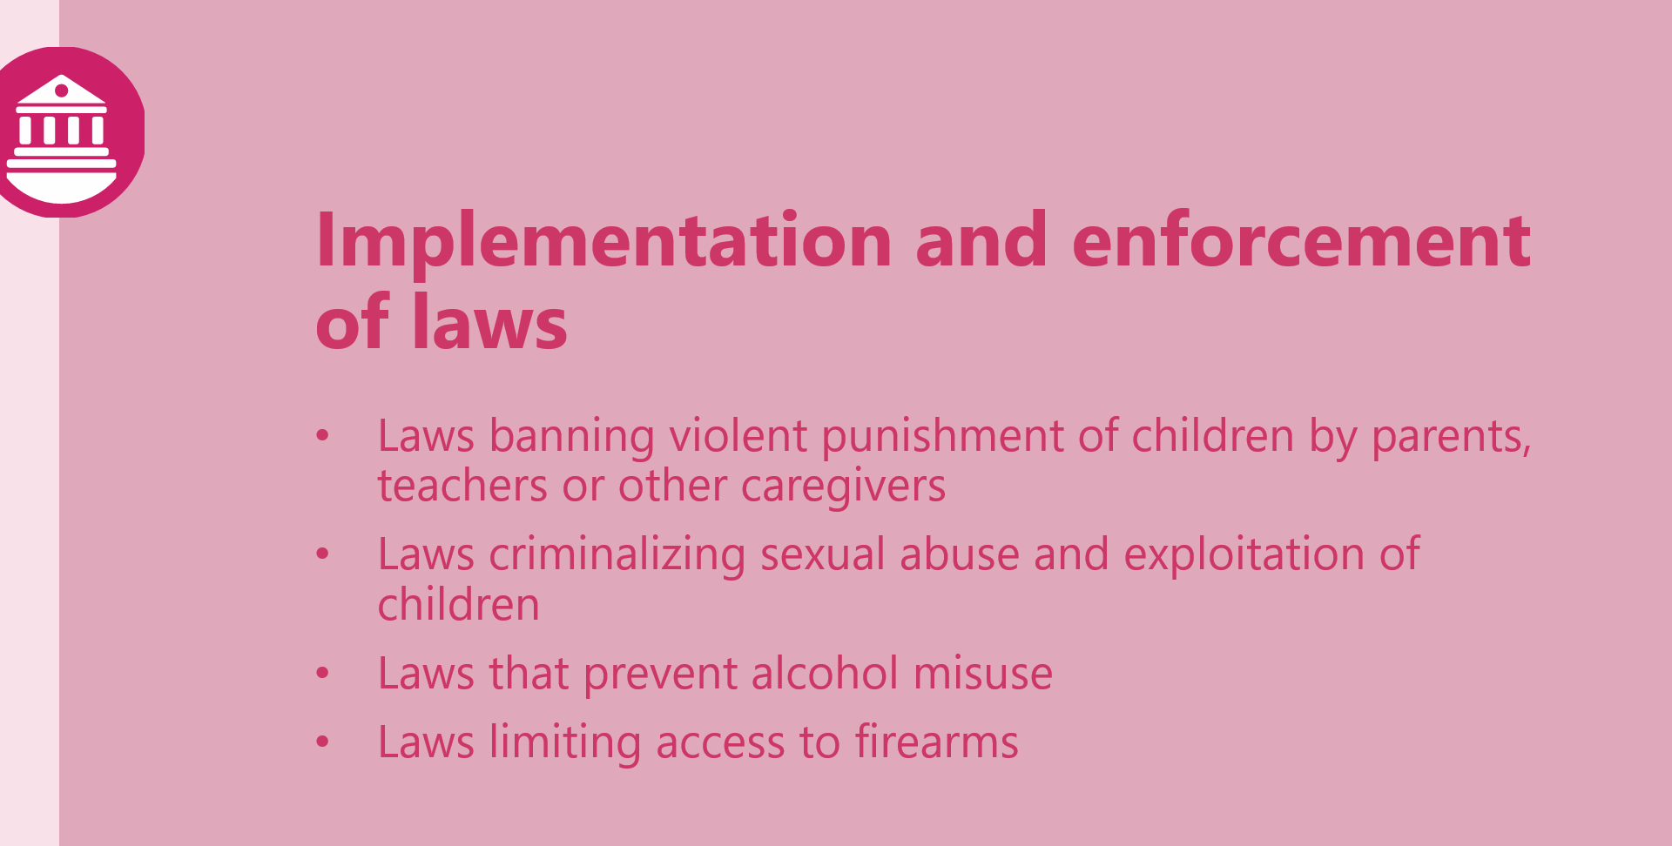
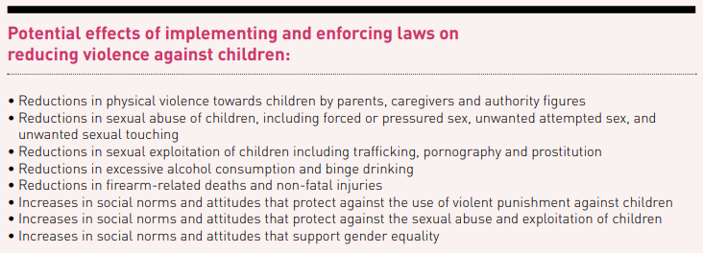
INSPIRE – The Approaches

Slide 27
Quiz – The Approaches
Approach: Cash Transfers
Response and Support Services
Norms and Values
Income and Economic Strenghtening
Safe Environments
Parent and Caregiver Support

Slide 28
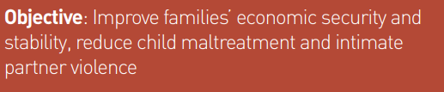
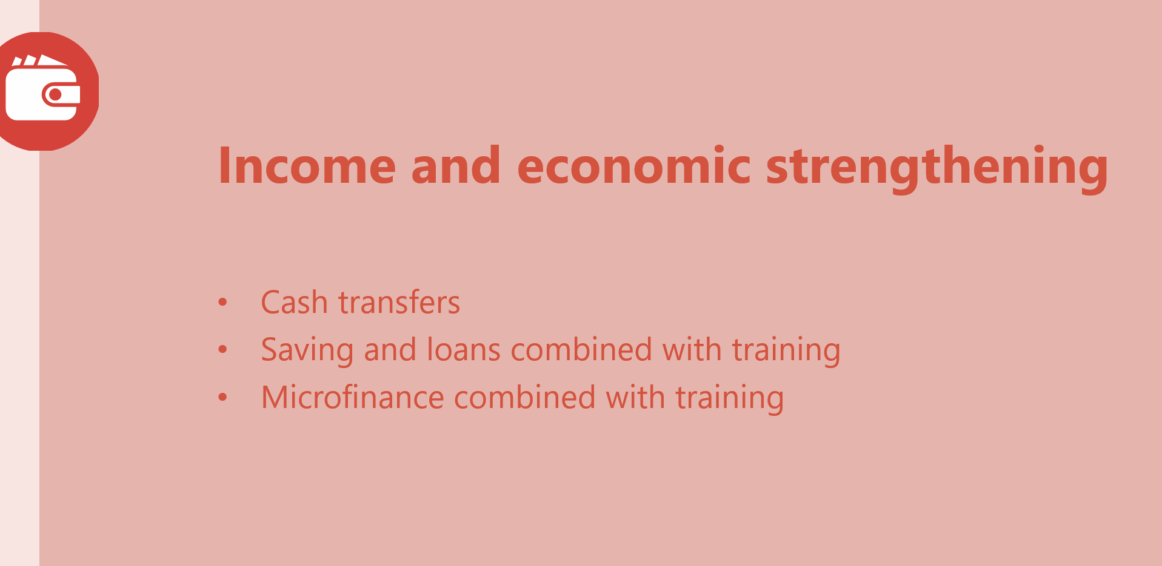
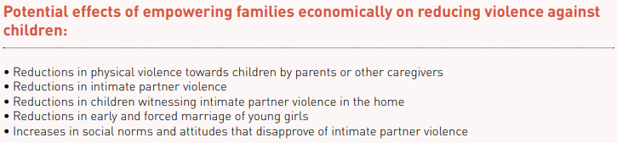
INSPIRE – The Approaches

Slide 29
Quiz – The Approaches
Approach: Life skills and social training
Norms and Values
Parent and Caregiver Support
Income and Economic Strenghtening
Response and Support Services
Education and Life Skills

Slide 30
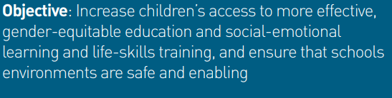
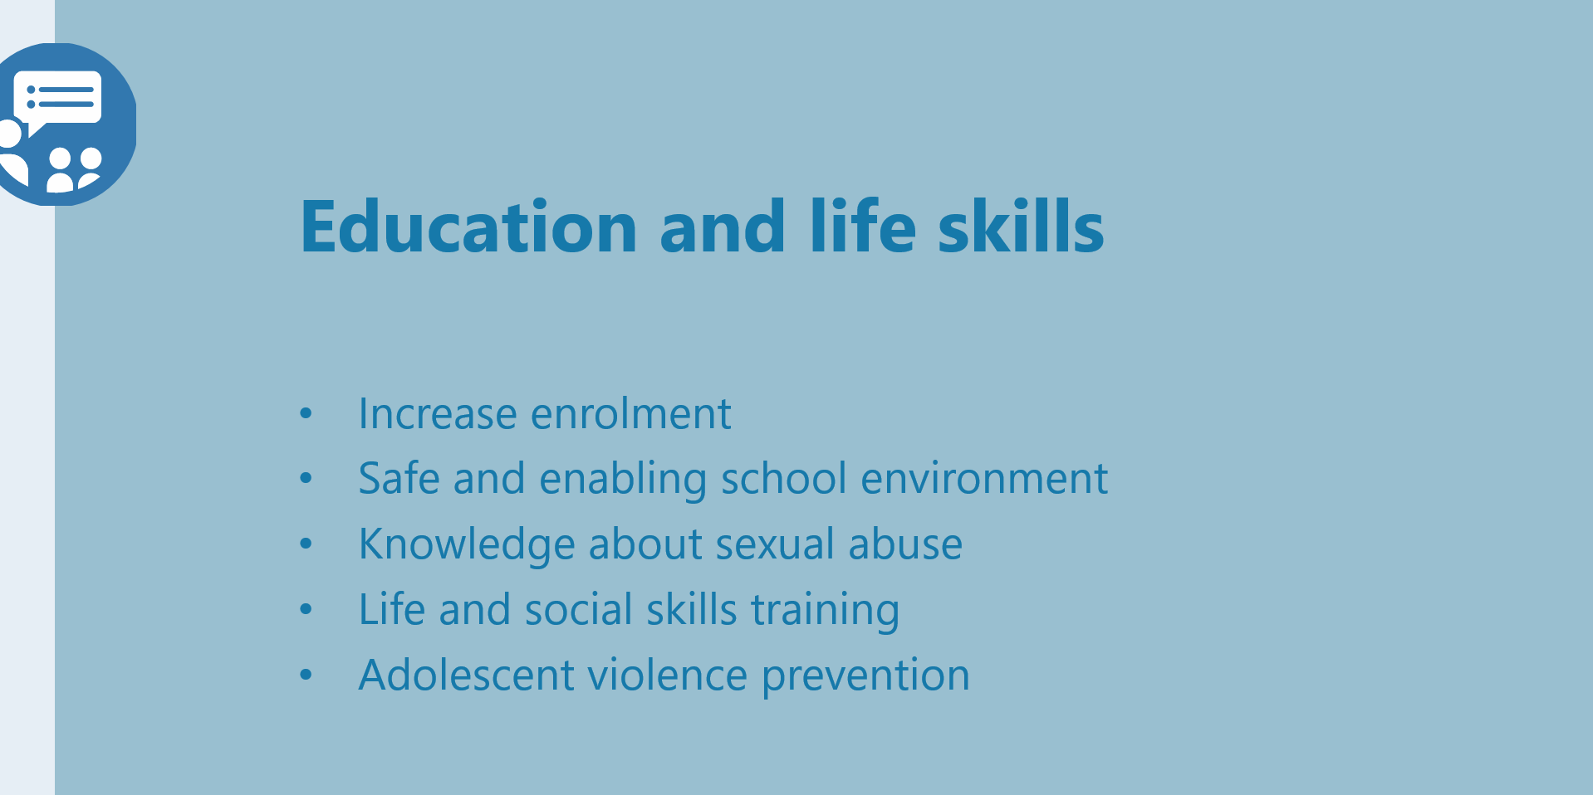
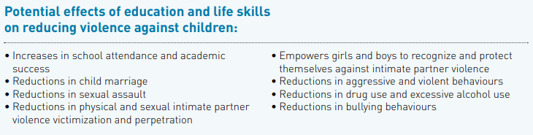
INSPIRE – The Approaches

Slide 31
Quiz – The Approaches
Approach:
Changing adherence to restrictive and harmful gender and social norms
Norms and Values
Safe Environments
Parent and Caregiver Support
Income and Economic Strenghtening
Education and Life Skills

Slide 32
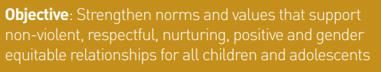
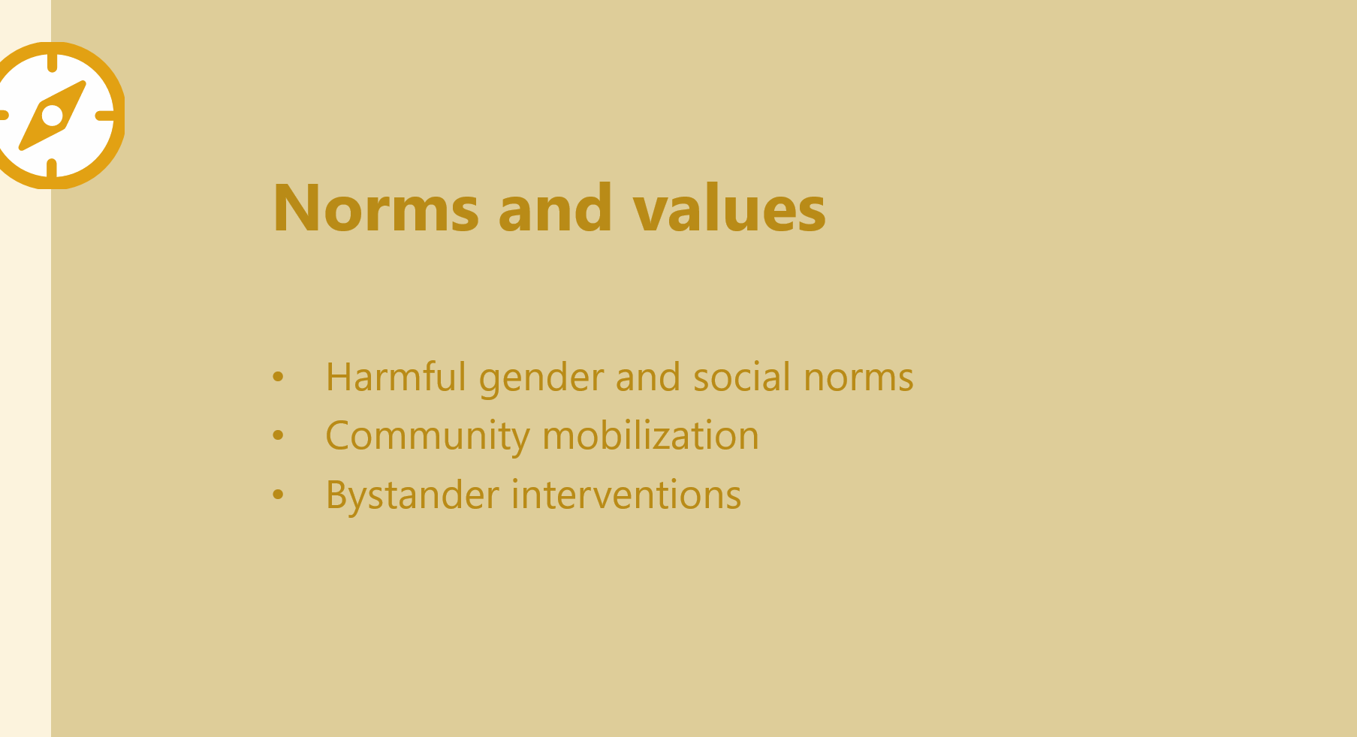
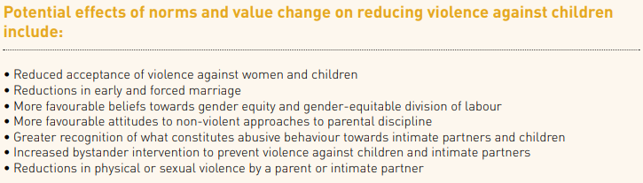
INSPIRE – The Approaches

Slide 33
Quiz – The Approaches
Approach:
Reducing violence by addressing „hotspots“
Implementation and Enforcement of Laws
Norms and Values
Safe Environments
Income and Economic Strenghtening
Response and Support Services

Slide 34

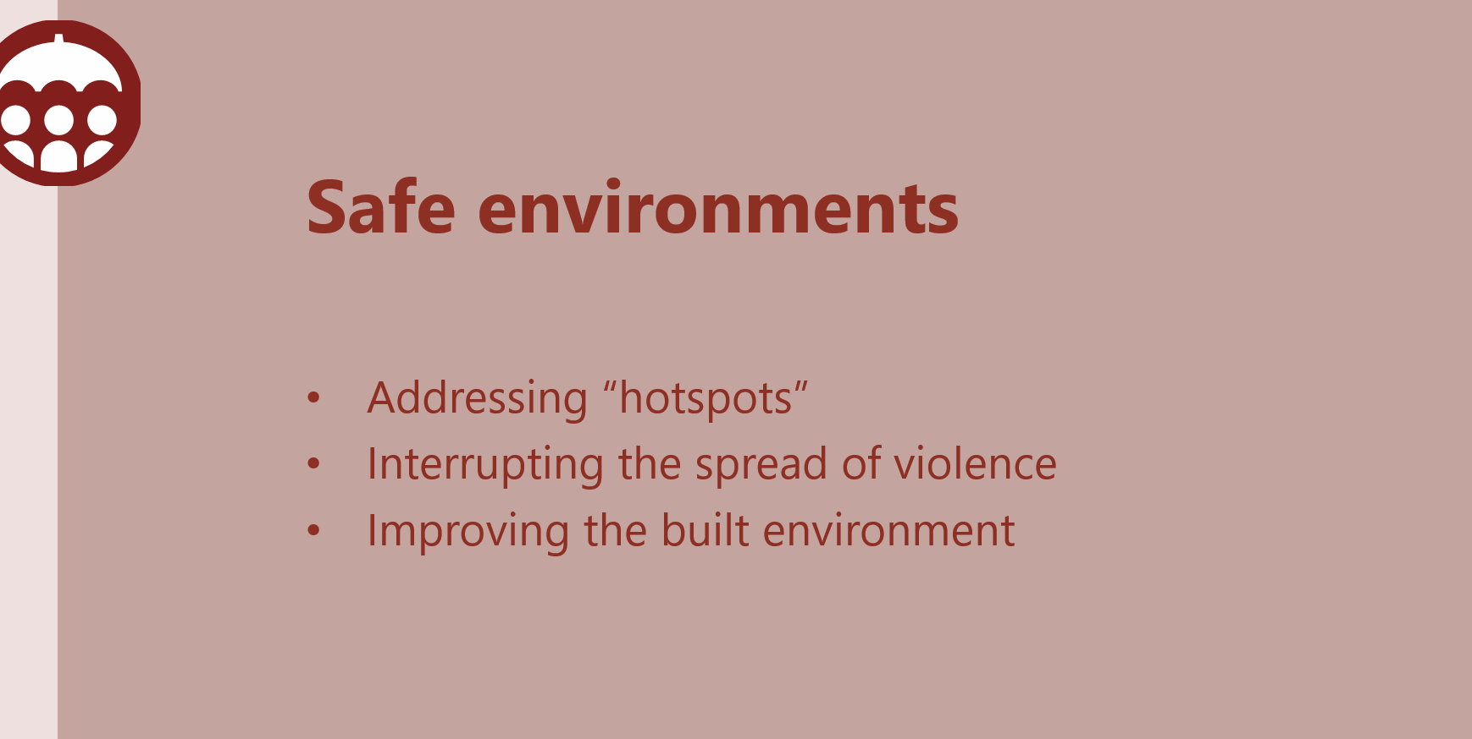
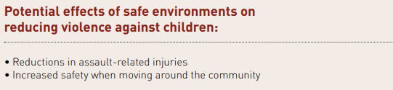
INSPIRE – The Approaches

Slide 35

QUESTIONS

Slide 36
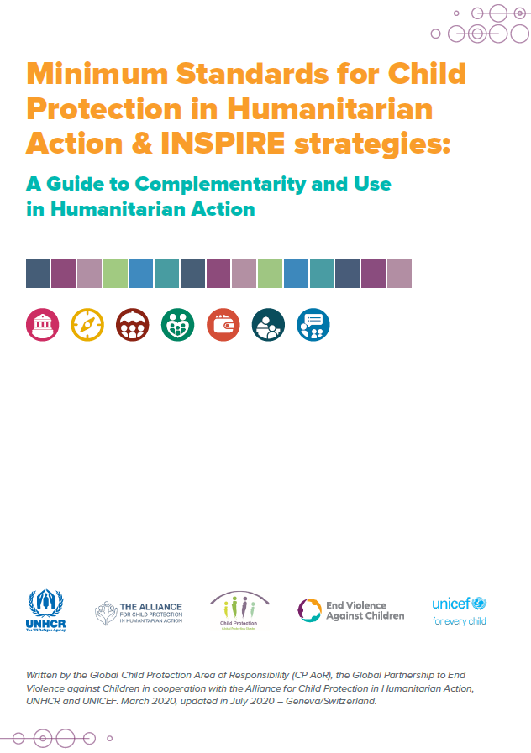



INSPIRE versus CPMS
INSPIRE & the Minimum Standards for Child Protection in Humanitarian Action (CPMS)
Complementarity & Use
Notes:
Objectives of the session:
To clarify the linkages and complementarity between INSPIRE seven strategies for ending violence against children and the 2019 CPMS
To provide some practical guidance on how to use both documents to prevent and reduce abuse, neglect, exploitation and violence against children in humanitarian settings

Slide 37
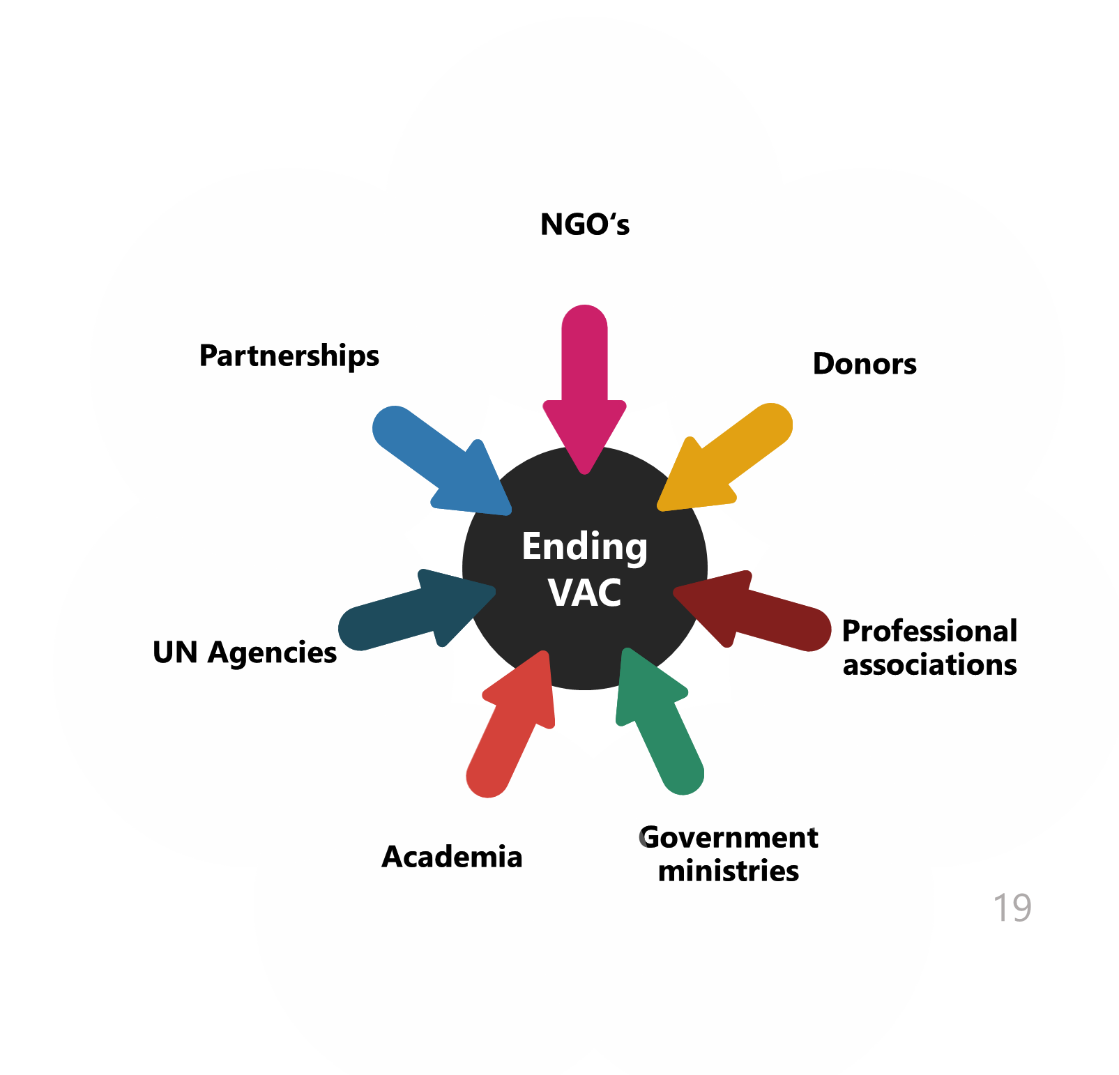
INSPIRE versus CPMS
Principles- what is similar?
Guided by CRC/ Children as agent of change
Focus on prevention
Multisectoral approach
Socio-ecological model
System strengthening approach
Can be applied in a range of contexts – reinforce nexus approach

Slide 38
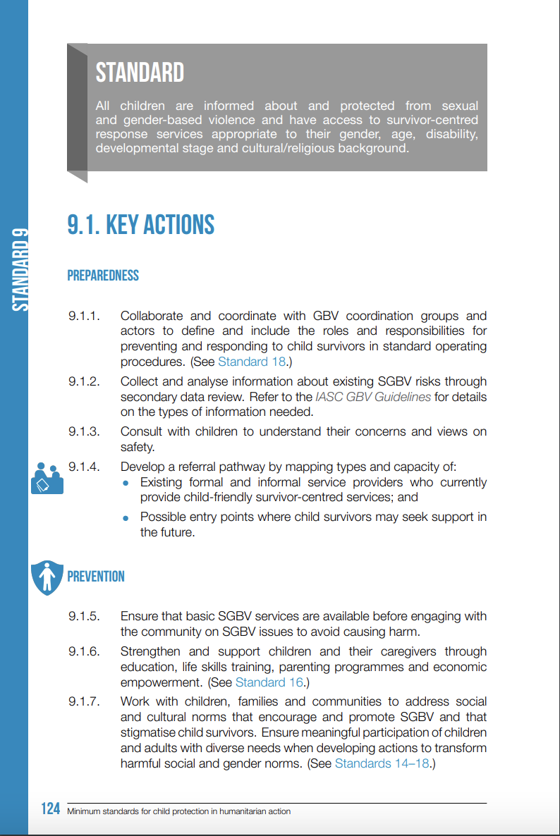
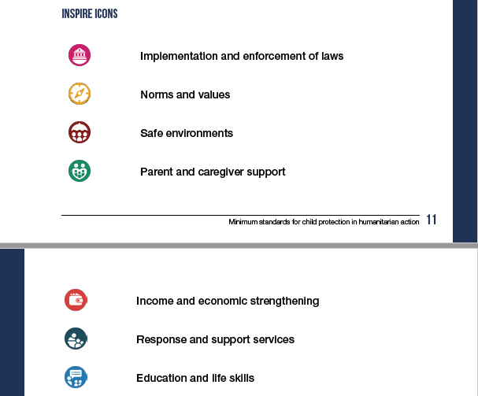


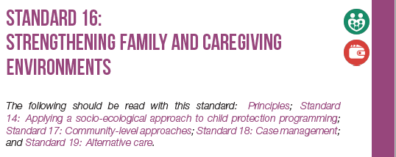
INSPIRE versus CPMS

Slide 39
INSPIRE versus CPMS
Specific considerations for implementation
How to use them jointly?
Both need to be adapted to the context.
CPMS can be implemented from the onset of a crisis while some INSPIRE interventions require more longer term resources and more stable environments to be implemented.
As with the CPMS, not all INSPIRE interventions would necessarily need to be implemented at once or together, depending on the context, identified needs, based on data and who is implementing it.

Slide 40
INSPIRE versus CPMS
Things you can do to integrate CPMS and INSPIRE
Use both the CPMS and INSPIRE strategies to guide preparedness activities
Identify, document and share evidence-based interventions implemented in humanitarian settings
Join the Alliance CPMS Working Group or the global INSPIRE Working Group to share experiences, challenges and knowledge with other practitioners.
Strengthen prevention activities or add them whenever possible, ensuring they are evidence-based.
Ensure linkages with other sectors and development actors working on prevention of abuse, neglect, exploitation and violence against children and responses through existing national or local coordination mechanisms.
CP Sub-Sector: Include some interventions in humanitarian response plans to support resource mobilization.

Slide 41


Slide 42

How do you feel?
Go to www.menti.com
Use the code 6740 0417
Notes:
Evaluation to see the learning curve

Slide 43
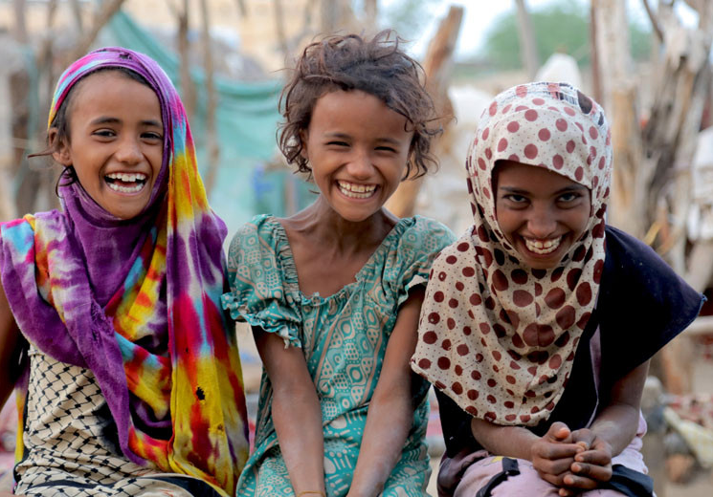

Thank you!
Next Sessions …
Session on Parent and Caregiver Support:
Thursday, 2.12.: 9:30 am – 12:30pm
Session on Response and Support Services:
Friday, 3.11: 10am – 12pm

