Slide 1
A joint webinar FROM xxx and Save the Children
Safe Back to School: An Inter-agency Practitioners Guide
Notes:
Include relevant branding/logos for other agencies
Introductions to panelists etc.
Very excited to be able to host this webinar as part of our launch of the Safe Back to School Practitioners Guide – led by Save the Children with contributions from many online today and reviewed and endorsed by both the Global Education Cluster, the Child Protection Area of Responsibility and supported by the Inter-agency Network for Education in Emergencies (INEE).
Today we welcome so many of you representing country offices, regional offices, SCI centre and members to go hear more about the key elements of the guide and have the opportunity to ask us questions and grill our technical advisors on specific areas of the Guide.
Notify audience we are recording

Slide 2
Forum Outline
Introduction
Safe Back-to-School Checklist
Q&A/Discussion
Reality check! SC Vietnam & Asia RO
Q&A/Discussion
Notes:
Emphasise that we want this online forum to be interactive so please feel free to ask questions using your Mic or chat in the chat box and we will do our best to answer them for you.
We also will have an opportunity to hear from the Vietnam CO AND the Asia Regional Officer on their experiences of preparing for a safe return to school – we want that part of the forum today to inspire you to also share your experiences at whatever stage you are at now – preparing to support schools to re-open or where you have already played a role in supporting the reopening already or just at the stage where it is still perhaps unclear what will happen.
Ask each facilitator to introduce themselves before they speak on their particular section (to save time at the beginning)

Slide 3
Safe Back to School: A unique opportunity!
INTEGRATION
TECHNICAL QUALITY
BUILD BACK BETTER
Notes:
(1min)
Integration -- being a shared priority across programmes, operations, technical, advocacy; COVID19 has highlighted how truly interconnected our sectors are, and this is an opportunity to work more efficiently and towards more impact for children if we work together ☺ At the heart of our Protect a Generation campaign!
Technical quality --- This guide has been written drawing upon our best practices, including from our common approaches like
SSCA
PwV
ET
As well as from previous responses like the Ebola crisis. By building on experience and evidence, we can make the COVID19 back to school experience much smoother and safer for children around the world.
Build back better: COVID19 surprised us! This is a change to get the foundations right for the next emergency – be it a health pandemic or another hazard like a cyclone or an outbreak of conflict.
Truly for SC, this guide offers an opportunity for SC values to shine!
Child participation is at the heart of the guide and it’s inter-agency, so others can integration ChP too
And the Thnow Child participation & Protect a generation!

Slide 4
Safe Back to School Guide Overview
Checklists
Integrated Safe Back-to-School Checklist for Program Staff: 6-pager providing key actions for Health, Nutrition, WASH, M&E, Education and Child Protection/MHPSS sectors before and after schools reopen to ensure sectoral integration the school reopening process.
School-Friendly Safe Back-to-School Checklist: 2-pager providing top line actions for a head teacher or school committee to follow.
Technical Annexes
Participatory, inclusive back-to-school campaigns
EdTech for absentee management systems
Enable teachers in the transition back to school
MHPSS for children as schools reopen
Participatory education and continuity planning
Adaptations for camp settings
Advocacy messages
Notes:
Integrated checklist:
Especially useful for project design and coordinated inter-sectoral planning (i.e. adaptations to the Humanitarian Response Plan) and for monitoring and oversight.
7 Technical Annexes: Annex 1 Participatory, inclusive back-to-school campaigns . Annex 2 Absence Management Systems . Annex 3 Enable teachers in the transition back to school . Annex 4 MHPSS for children as schools reopen . Annex 5 Participatory education and protection continuity planning . Annex 6 Adaptations for camp settings . Annex 7 Advocacy messages

Slide 5
Who should use this guide?
You!
Program teams
Coordination teams
Advocacy teams
Together with partners!
Inter-agency
Inter-sectoral
All contexts
Notes:
(1 min) Highlight the value of the guide being an interagency piece and how this changes how SC colleagues can use the guide
The guide aims to be a user-friendly, practitioner-focused tool that outlines the key steps needed for a coordinated, inclusive, all-hazards approach to school reopening and links to further guidance where appropriate.
Coordination teams (such as Child Protection Area of Responsibility, Education Cluster, EiE Working Group Coordinators, Refugee Education Groups or Local Education Groups) are encouraged to share this document and reference this guidance as coordinated school reopening strategies are developed and operationalized.
Highlight based on existing guidance/UN framework etc.

Slide 6
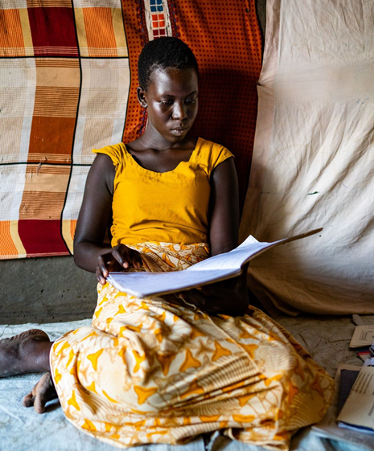
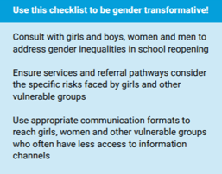
Key Principles for Safe Back to School
An integrated approach
Child & youth participation
Gender, inclusion, and accessibility
Whole school community
Build on existing structures
Build back resilient
©Save the Children
Notes:
-emphasize that you can use this checklist to be gender transformative!

Slide 7
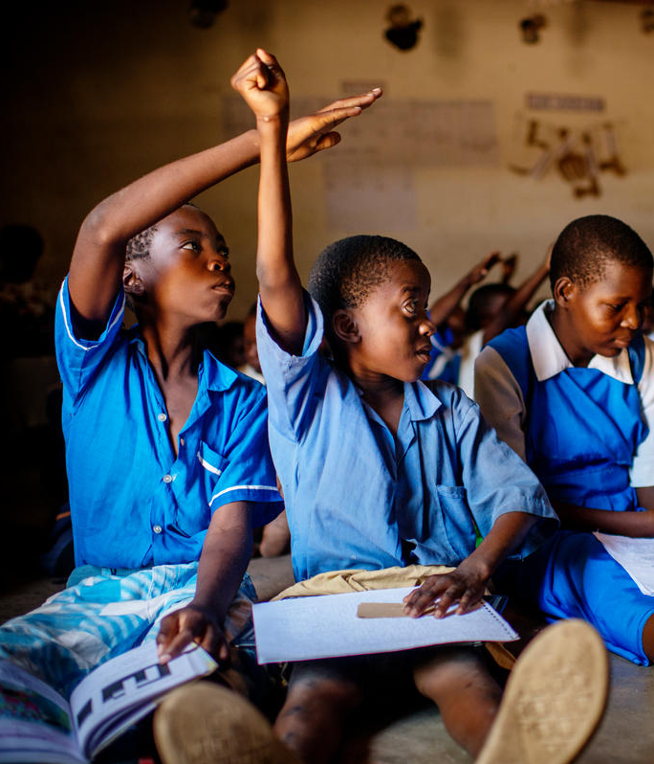
Integrated Safe Back-to-School Checklist for Program Staff
©Save the Children

Slide 8
Safe Back-to-School Checklist MEAL
Before Schools Reopen:
Engage the whole community, including children and young people, in back-to school planning and campaigns using participatory methods.
Use this Checklist to develop a participatory Safe Back to School monitoring tool to track progress with the whole school community. This can also be used to aggregate progress on reopening at district or national levels.
After Schools Reopen:
Conduct needs and gender assessment using participatory methods
Conduct a rapid needs assessment on the education, CP/MHPSS, WASH and H&N needs now that schools have reopened. Assess how much children and young people continued learning during school closures and what support is needed to return to school.
Refresh or establish accessible, gender and age-friendly accountability and feedback mechanisms
Notes:
Included bolded action points from the before schools reopen checklist and after schools reopen checklist

Slide 9
Safe Back-to-School Checklist HEALTH/NUTRITION & WASH
Before Schools Reopen:
Clean and disinfect the school facilities with emphasis on surfaces that are touched by many people.
Engage whole school community in cleaning and maintenance for school reopening
After Schools Reopen:
Ensure that cleaning and disinfection measures are effective and regular
Encourage equal sharing of water sourcing and cleaning tasks between women and men.
Educate children and young people about good hygiene, health, nutrition and menstrual hygiene.
Increase air flow and ventilation
Notes:
Included bolded action points from the before schools reopen checklist and after schools reopen checklist

Slide 10
Safe Back-to-School Checklist EDUCATION
Before Schools Reopen:
Prepare school for physical distancing in, around, and on the way to schools
Take action to ensure all children and young people return to school, prioritizing the most vulnerable
Support school personnel well-being and train teachers on key topics and pedagogy to ensure a safe, quality return to school (see Technical Annex 3)
After Schools Reopen:
Prioritize psychosocial support and socio-emotional learning activities in the reopening period
Include basic MHPSS or SEL activities into daily classroom routine (see Technical Annex 5)
Identify additional learning needs (see Technical Annex 3)
Prepare for recurring or future school closures
Notes:
Included bolded action points from the before schools reopen checklist and after schools reopen checklist
- Focus on checklist: presenting key elements and signposting (provide example of one or two key actions)
- Signposting technical annexes

Slide 11
Safe Back-to-School Checklist CHILD PROTECTION/ MENTAL HEALTH AND PSYCHOSOCIAL SUPPORT (MHPSS)
Before Schools Reopen:
Prepare teachers and education personnel to meet the psychosocial and protection needs of children and young people and to manage their own health and wellbeing (see Technical Annex 3)
Update/establish effective referral mechanisms
Update school-based reporting and referral mechanisms for protection and health concerns, ensuring they are gender-sensitive, inclusive and age-appropriate adapted for COVID context if necessary. Test communication channels.
Organize with child protection case workers and/or social workers to support school reopening
After Schools Reopen:
Ensure psychosocial support for children and young people, prioritizing girls and other vulnerable groups (see Technical Annex 4)
Identify children and young people in high distress and/or with mental health conditions and refer them to specialized services. Coordination of MHPSS activities and referrals across sectors, including Education, CP and Health, is coordinated by MHPSS Technical Working Groups (where they exist) at country level).
Notes:
Included bolded action points from the before schools reopen checklist and after schools reopen checklist
We know that the impact of COVID-19 on the protection of children is significant both in terms of increased risk of violence and abuse due to confinement at home but also due to the inaccessibility of local child protection mechanisms, including those in the school, to monitor, report and respond to concerns children have.
So the actions included in the Guide related to Child Protection focus on:
BEFORE schools re-open:
Adapting school-based reporting and referral mechanisms
Ensuring continuity of referral to local child protection mechanisms and services
Information and advice to children and school staff if they have concerns about a child / another child
Facilitating coordination between education and child protection actors
AFTER schools re-open:
Ensuring school-based reporting and referral mechanisms are functioning (revitalising them if they are not)
Identifying children in need of support and/or referral
Delivering age-appropriate, gender and inclusion-sensitive messaging to prevent violence, abuse, bullying (as a result of stigma, for example)
Additional note on Technical Annex 3 – Enable teachers in the transition back to school- includes some specific guidance for teachers on identifying and reporting protection concerns – links to TPD module which focuses on psychological first aid, violence prevention and response.
Additional note on Technical Annex 5 – Participatory Education and Protection Continuity Planning –task presents a unique opportunity to re-visit protection risks, pre and post-COVID-19 and reassess school plans

Slide 12
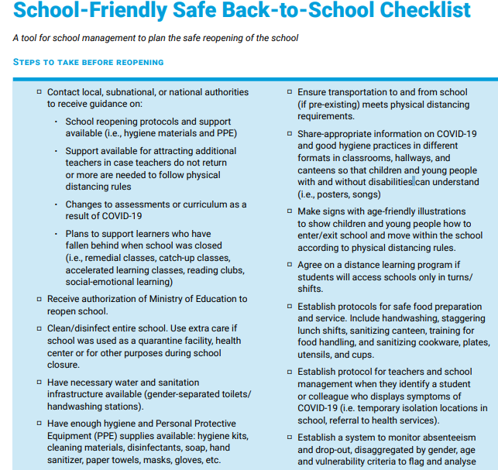
School-Friendly Safe Back-to-School Checklist for head teachers or school committees

Slide 13
Temperature Check!
On a scale of 0 to 1 000 000, how useful will this guide be for planning an integrated, safe return to school in your context?
0 = Totally useless!
1 000 000 = AMAZING!!!!!!

Slide 14
Q&A / Discussion

Slide 15
e.g. How excited are you to hear about Vietnam’s experience with safe back to school?
Put your emoji in the chat!
Notes:
Optional fun slide to grab attention!

Slide 16
Country Example

Slide 17
Country example

Slide 18
Q&A / Discussion

Slide 19
WE WANT TO HEAR FROM YOU!
Share your best practices and adaptations!
Want to know more?
(include email contacts)

Slide 20
THANK YOU!
Notes:
Include relevant branding/logos for other agencies

