Slide 1


CP AOR, HPC cycle Support Webinar:
Humanitarian Need overview (HNO) and Humanitarian Response Plan (HRP) process

Slide 2
The Overarching protection severity, and linkages with AoRs
CP AoR specifics: Severity, PIN, CIN, targeting (tools and methodologies)
B R E A K
CP AoR specifics: PIN, CIN, targeting (tools and methodologies)
Q&A
Wrap Up, Closing remarks & Next steps
Final evaluation

Slide 3
PC & AoRs Context analysis, overarching Severity Scale and PiN
Notes:
5 min

Slide 4
Context-based analysis
Joint consolidation and analysis of context, shocks and impact information and indicators, with a strong focus on protection risks/ violations, as a main step in the HNO aiming at establishing the scope of the analysis
Key outputs:
  Identification of priority affected geographic areas
  Identification of most affected / vulnerable population groups

Slide 5
Step 1. Identify and consolidate available information and indicators.
Identify the available indicators for each specific context and aggregate or disaggregate them to the selected geographical unit of analysis ensuring they are comparable between each other.
Example
Context-based indicators reference table
Sector | Indicator
Protection | Civilian casualties by violence / conflict / disaster
Protection/GBV AoR | Presence of armed forces, militias in the geographical area
Protection/GBV AoR | % of female headed households.
Protection/CP AoR | CAAFAG presence/prevalence
Cross | Presence of refugees
Nutrition | Prevalence of exclusive breastfeeding for children 0-5 months
Health | Average population per functioning health facility (HF), by type of HF and by administrative unit
…. | …..
Notes:
Indicators in list only as examples for inspiration – adapt to what is relevant in context, available/collectible data, etc

Slide 6
Step 2. Define context-based indicators thresholds
With the support of the JIAF team and in country IMWG; Clusters and AoRs will decide on the thresholds for each of their indicators thanks to their sectoral expertise.
Example
Sector | Indicator | Area 1 | Area 2 | Area 3 | Area 4
Protection | Civilian casualties by violence / conflict / disaster
Protection/GBV AoR | Presence of armed forces, militias in the geographical area
Protection/GBV AoR | % of female headed households.
Protection/CP AoR | CAAFAG presence/prevalence
Cross | Presence of refugees
Nutrition | Prevalence of exclusive breastfeeding for children 0-5 months
Health | Average population per functioning health facility (HF), by type of HF and by administrative unit
Notes:
Process here can follow binary analysis – Yes/No… Scoping process is just as much about excluding areas that are not relevant to HNO/HRP. PiN is measured following the inter-sectoral severity mapping (see following steps)

Slide 7
Step 3. Joint interpretation/analysis
Plenary joint analysis sessions for analysis and interpretation for each of the geographical units of analysis
Outcome of these sessions will be an Inter-sectoral consensus on the most affected geographical areas by the crisis
Area 1 | Area 2 | Area 3 | Area 4
Low | Medium | High | Medium
Area 1 | Area 2 | Area 3 | Area 4
Not priority | Priority Areas |  | Not priority
Notes:
Data under step 2 may provide a certain picture; but analysis is what will ultimately determine priority and non-priority areas in the scoping exercise.
Analysis can override what data show (overcome gaps or unreliable data, etc)

Slide 8
Step 4. Identify and profile affected population groups
Identification of the affected population groups in prioritized geographical areas, using estimates of the number of people affected as defined in the 2016 IASC Humanitarian profile Support Guidance.
Example
Affected population groups in the priority geographical areas
# of non-displaced people living in areas affected / exposed to conflict, violence, natural hazards, outbreaks or any other shock (disaggregated by gender and age )
# of people internally displaced by type of accommodation (dissag. by gender, age, disability)
# of returnees (dissag .by gender, age, disability)
# host population (dissag. by gender, age, disability)
# of refugees (dissag. by gender, age, disability)
Others

Slide 9
Overarching Severity and PiN
  Identify and select overarching and specific indicators (reference table / consultation with global team)
    Ideally the same ones identified for inter-sectoral analysis
    And additional ones to further refine your sectoral analysis as needed, including other sectors’ indicators relevant for protection analysis
  Data consolidation and severity scoring
  Joint analysis an interpretation (expert workshops)
  PiN calculations linked to severity scores and affected / vulnerable groups in prioritiy areas
Notes:
Step 2 (intersectoral) & 3 (sectoal) in parallel, not linear
(e.g. if they were cut but important for your sectoral ranking) = delete, replace with “to further refine your sectoral analysis as needed”
expert workshops = cluster SAG or coordinators + key operational partners + field/sub-national cluster coordinators

Slide 10
EXAMPLE
Step 1. Identification & Selection of the available indicators
PC -Overarching Severity Scale | Minimal | Stress | Severe | Critical | Catastrophic
Civilian population killed or injured by violence, conflict or natural hazards (per 100,000 hab) | Less than 5 | Between 5 and 10 | Between 10 and 15 | Between 15 and 20 | More than 25
% of population in sites/communities reporting protection incidents | Less than 20% | Between 20% and 30% | Between 30% and 40% | Between 40% and 50% | More than 50%
Areas contaminated with explosive ordnance | No confirmed EOs contaminated sites | Between X to X confirmed EOs contaminated sites | Between X to X confirmed EOs contaminated sites | Between X to X confirmed EOs contaminated sites | More than X confirmed EOs contaminated sites
# Attacked health facilities (from Health Clusters indicators list) | No health facility attacked | Between x and x facilities attacked reported | Between x and x facilities attacked reported | Between x and x facilities attacked reported | More than x facilities attacked reported
….

Slide 11
EXAMPLE
Step 2. Data consolidation & Severity scale scoring
Protection Cluster Overarching Severity Scale | None/Minimal | Stress | Severe | Critical | Catastrophic
Area 1
Area 2
Area 3
AoR Specific Severity Scale | None/Minimal | Stress | Severe | Critical | Catastrophic
Area 1
Area 2
Area 3

Slide 12
EXAMPLE
Step 3. Joint analysis Severity scale scoring
Protection Cluster Overarching Severity Scale | None/Minimal | Stress | Severe | Critical | Catastrophic
Area 1
Area 2
Area 3
AoR Specific Severity Scale | None/Minimal | Stress | Severe | Critical | Catastrophic
Area 1
Area 2
Area 3

Slide 13
Tips/recommendations on indicators
It is feasible to use context-based and protection inter-sectoral indicators for the overarching and AoR Specific severity scales. First action should be always to jointly decide where and how each indicator will be used.
Focus of the PC and AoR analysis should be always in the most affected areas and with the most affected groups prioritized in the context-based analysis.
The use of other sectors’ indicators in the overarching and AoR specific scale is recommended, it will reinforce the centrality of protection of our analysis.

Slide 14
EXAMPLE
Step 4. Calculation of PiN estimates
Based on severity mapping for each affected area, use scale % to calculate PiN
        E.g.: Scale 5 areas = 90-100% IDP population, 60-80% host population; scale 4 = 60-75% of IDPs, etc
AoR specific PiN cannot be higher than the Overarching PC PiN
Disaggregate PiN by gender, age, disability
CP AoR has defined a MHPSS PiN methodology aligned with this approach
The use of other sectors’ indicators in the overarching and AoR specific scale is recommended, it will reinforce the centrality of protection of our analysis

Slide 15
Final recommendations
  Linear presentation but non-linear process and keep whole process/steps in mind from the beginning as they are interconnected
  Secondary data review is key (all area and HH level data should be considered)
Agree on what you need to know/do, what indicators are for/measuring
The stronger the sector data and analysis (with also the context & intersectoral analysis in mind), the stronger our contribution and influence of the intersectoral data and analysis
  Don’t get stuck in ‘mathematical’ PiN calculations
  Focus on quality narrative: protections risks as key drivers / contributing factors as well as protection consequences of the crisis
  Highlight groups with specific needs, context-specific, priority areas

Slide 16
What is this session about?
Identify Affected areas and Pop Groups
Inter-Sectoral Severity & PiN
Ways to Estimate CP Severity, CiN and targets
Process for estimating strategic figures
Overarching Severity & PiN
CP Severity & CiN (Children in Need)
CP Target population (Children & Adults)

Slide 17
Types of PiN
What are People in Need of?
Where is the CP AoR?
Inter-sectoral Severity & PiN (JIAF)
Health, Food, WASH, Shelter&NFIs, Education, Protection, GBV, MA, CP
CP contribute
Protection, GBV, MA, CP, HLP, CT
CP contribute
Overall Protection Severity & PiN
CP Severity and Children in Need (CiN)
CP is responsible for this
Child Protection
Notes:
Remember that we contribute to all level of Severity and PiN calculation with Indicators relevant to CP.

Slide 18
To agree with others before we can calculate CP severity & CiN:
Affected areas and pop groups (IDPs, Ref, Host Community…) identified at Inter-Sectoral level (Clusters & OCHA)
Geographical units of analysis used in the HNO/HRP (Governorate, province, districts…)
Agree with Protection & AoRs how the Overall Protection Severity will be calculated
Agree with Protection & AoRs on % of PiN for each population group and level of Severity (incl. 1 and 2?)

Slide 19
But in practice, how do we estimate CP severity?
2 Possible ways:
Using CP and other indicators + Overall Protection Severity
Using CP and other indicators when you do not have results of the Overall Protection Severity
Notes:
Notes:
Because there is no agreement on the overall severity method
Optional

Slide 20
CP SEVERITY ANALYSIS - Scenario 1:
  Child Protection Indicators (agreed by the AoR) were used, together with other protection indicators, to calculate the Overall Protection Severity
    Use the Overall Protection Severity as a basis. Identify additional indicators to further refine the analysis for child protection :
      You can use both CP-specific indicators that were not included for the Overall Protection Severity, as well as indicators from other sectors (e.g. Education) or CP
    Calculate the severity level scores for CP per each area.
      Give a weight for the Overall Protection severity score (e.g. 50%) and add your additional CP indicators in your calculation
    Discuss the severity analysis with CP experts and add expert judgement to refine the final CP severity level of each area. These can be different from results of step b)

Slide 21
CP SEVERITY ANALYSIS - Scenario 1:
Example of CP severity using scenario 1
Location | Overall Protection Severity score | CP indicator #1 | CP indicator #2 | CP indicator #3 | CP severity score | Total CP severity score | Final CP severity score (with expert judgement)
Area 1 | 4 | 3 | 4 | 3 | 4 | 4 | 4
Area 2 | 3 | 1 | 1 | 1 | 1 | 2 | 1
Area 3 | 1 | 4 | 3 | 4 | 4 | 3 | 4

Slide 22
CP SEVERITY ANALYSIS - Scenario 2:
  Overall Protection Severity is not available/not used as a basis for CP severity calculation
    Use the indicators the AoR will recommend for overarching severity calculation, and add additional indicators to further refine the analysis for child protection:
      This can be CP-specific indicators and indicators from other sectors (e.g., Education, Mine action), even if they are used to calculate the Overall Protection Severity (because you do not include the result of the Overall Protection severity in your CP CiN calculation).
    Calculate the severity for CP based on all the selected indicators
    Discuss the severity analysis with CP experts and add expert judgement to refine the final CP analysis. These can be different from results of step b)
Notes:
- difference with the first scenario,
- we cannot use the same indicators twice. IN THE SAME calculation: we can use the same indicators +others IF you do not also include the result of the Overarching Protection Severity.

Slide 23
CP SEVERITY ANALYSIS - Scenario 2:
Example of CP severity using scenario 2
Location | Overall Protection indicator #1 | Overall Protection indicator #2 | CP indicator #1 | CP indicator #2 | CP indicator #3 | Total CP severity score | Final CP severity score (with expert judgement)
Area 1 | 4 | 3 | 4 | 3 | 4 | 4 | 4
Area 2 | 3 | 1 | 1 | 1 | 1 | 2 | 1
Area 3 | 1 | 4 | 3 | 4 | 4 | 3 | 4

Slide 24
CP SEVERITY ANALYSIS: recommendations
  Recommendations:
  The thresholds used for each indicator are the basis to calculate the severity score: it is the responsibility of the CP coordinator and CP experts to jointly discuss and validate these thresholds: IMO’s responsibility is to support.
  Coordination with PC/AoRs colleagues shall be initiated at the first stage of the process to agree on the methodology to use for Overall Protection Severity.
  Use each indicator only once in each severity calculation: if you use overall protection severity to calculate the CP severity, do not add indicators already used to calculate the Overall Protection Severity.
  Always discuss the results of the severity mapping with CP experts who know the context (operational experts, field coordinators) for feedback and validation.

Slide 25
CP SEVERITY ANALYSIS: What if…?
    …CP severity results are VERY different compared to Overall Protection Severity?
      Consider the indicators for the Overall Protection severity & check the data and identify what is creating the discrepancy
      Document in writing the explanation, to include in the HNO
      If needed review the threshold/scoring used for Overall Protection or for the CP severity mapping
      If appropriate, consolidate the data and re-calculate the severity score
Notes:
This could happen if using Scenario 2

Slide 26
CP CiN/PiN CALCULATION
  Apply a percentage for each severity level and each groups to estimate the CiN/PiN
  Identify the percentage (%) to use for each vulnerable group (IDPs, HC, people living in affected areas, etc.) per severity level (responsible: Coordinator and CP experts, not IMO)
  Remember: For CP AoR, severity levels lower than 3 does not negate the identified needs for some population groups (e.g. IDPs, refugees, returnees, etc.). Based on the context, a % can be also applied to vulnerable groups at severity level 1 and/or 2.
Example: actual % should be defined by CP experts in country
Severity Scale
IDPs
Refugees
Migrants
Returnees
Host
5
100%
100%
100%
100%
50%
4
80%
100%
80%
80%
50%
3
50%
100%
50%
50%
50%
2
100%
1
100%
Notes:
UNDESA
The % should be in line with other Protection & AoRs colleagues use (decide together)
The inter-sectoral PiN calculation is usually done only on levels 3, 4, and 5 to calculate and categorize PiN estimates as “severe, extreme or catastrophic”.
About the CIN in level 1 and 2, consider that CP, as other sectors (Protection, GBV, CCCM and Health) will have “pockets of vulnerability” (as JIAF guide calls them) in area level 1 and 2. It is justified to calculate CiN also for level 1 and 2 areas.

Slide 27
CP CiN/PiN CALCULATION
  Disaggregate the CiN by age, gender and disability
      The population data should be the same used at inter- sectoral level and should be disaggregated by age, gender and disability
      As much as possible, disaggregate the CiN by age group using the sphere standards (0-5, 6-12, 13-17).
Notes:
UNDESA

Slide 28
CP CiN/PiN CALCULATION: What if…?
    CP CiN is higher than the Overall Protection PiN
      Discuss and review the methodology used to calculate the CP CiN (review the thresholds and/or % applied to vulnerable groups)
    SADD is not available
      Use other sources for estimates (census data, UNDESA, DTM for IDPs, etc.)
      Liaise with other sectors targeting the same age groups (e.g. Education)

Slide 29
CP TARGET CALCULATION
  Estimate the targets for specific CP interventions: always use CP severity analysis as a basis for target calculation
    Based on the context analysis, identify key needs by priority areas and vulnerable groups (e.g.: awareness raising for children at risk, CAAFAG reintegration, UASC case management, etc.)
    Use the methodology in the Guidance for MHPSS aspects of child protection in the HNO/HRP 2021 to estimate children (and their caregivers) to target for Psychosocial Support (PSS)
    Use sectors’ indicators to underline CP specific needs (e.g. children out of school, FS negative coping mechanism) for CP interventions
Notes:
Note

Slide 30
CP TARGET CALCULATION
  Parameters to consider for target calculation:
    Severity of needs: the CiN estimates categorized as “severe, extreme or catastrophic” help to prioritize CP interventions in the most affected areas/vulnerable population groups
    Access constraints: population in affected areas without access should be taken into account for response at a later stage, if there is a potential evolution of the situation
    Capacity outside the HRP: interventions outside the HRP response should be considered to exclude the needs that are covered by other actors (ICRC, Gov., private sector, etc.)
    Performance history: used as a baseline, it helps to capture and evaluate CP response capacity for a better planning (e.g. expected coverage)
Notes:
Note:
Estimate existing capacity of and potential coverage by actors outside cluster/sector and broader inter-agency response plans

Slide 31
CP TARGET CALCULATION
  Recommendations :
    Minimize duplication in activities’ targeting with other AoRs such as Gender-Based Violence (GBV), being cognizant of common targets among the AoRs.
    Minimize overlaps in CP programming targets: for instance, adding up targets for case management with PSS targets as illustrated below (Do not sum up)
    Avoid double counting: target aggregation works only for exclusive categories (e.g. children and adults) and geographic locations.

Slide 32
CP TARGET CALCULATION
  Remember :
    CP target is a sub-set of CP CiN/PiN: the target calculation should be based on CP CiN/PiN figures;
    Capacity outside the cluster should be taken into account, to exclude the portion of PiN that is expected to be reached by other actors;
    Avoid double counting and minimize overlaps in target calculation;
    Targets are not static and may need to be adjusted through the year to respond to changed information on the PIN (MYR, HRP addendum).
Notes:
- Adjusting targets – Targets may need to be adjusted through the year to respond to changed information on the PIN (e.g. Covid-19). Adjusting targets must done through a revision of the HRP (MYR, HRP addendum);

Slide 33

Notes:
Generic end of session slide – Questions / Comments

Slide 34
MHPSS elements of Child Protection in HNO and HRP
CP AoR

Slide 35
The purpose of this note is to provide operational guidance for CP AoR coordination teams:
in defining CIN/PIN for MHPSS aspects of child protection;
in setting a target for the number of children and caregivers receiving MHPSS services;
in defining the activities to meet the needs of children and caregivers.

Slide 36
This guidance builds on lessons learned from the guidance of the previous year:
CIN is defined in a more realistic way;
Targets are be set in function of the situation in the country;
A greater focus is placed on capacity building of the MHPSS Workforce.

Slide 37
Following the guidance will lead to:
A more targeted number of beneficiaries for PSS activities.
A bigger variety of activities for MHPSS aspects of child protection;
More integrated approaches for MHPSS across sectors.

Slide 38
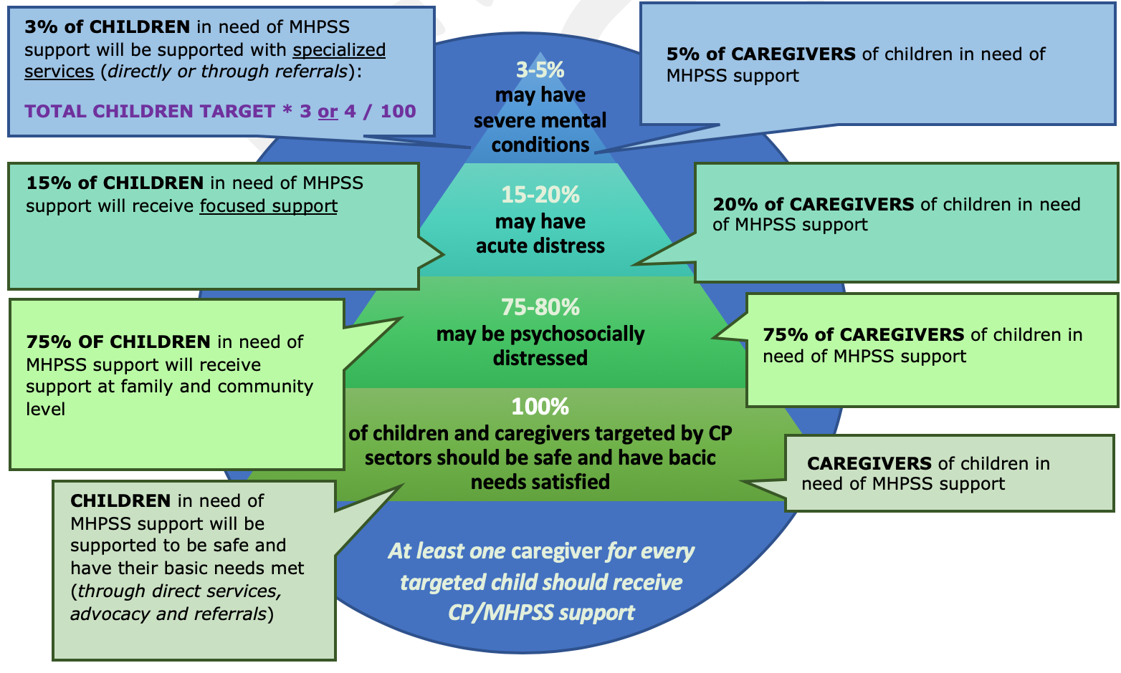

Slide 39
Steps to determine CIN of MHPSS services
Step 1: gathering essential information to estimate how many children are in need of MHPSS services and have access to services.
In step 2: adjusting these numbers in line with what is considered good practice in MHPSS.
In step 3: summarizing conclusions.

Slide 40
Step 1:
Table 1: Your findings | Numbers
Overarching CIN in the prioritized geographical area
How many children can be assisted on level 2 in 2021
How many children can be assisted on level 3 in 2021
How many children can be assisted on level 4 in 2021
Average number of children per household

Slide 41
Step 2: adjustements for good MHPSS Practise
What percentage of children can be assisted on level 2,3,4 in relation to the CIN in prioritized areas? %
If the percentage on level 2 exceeds 75%, you have to calculate 75% of the CIN in prioritized areas to obtain an adjusted number of children who can be assisted on level 2. If the percentage is 75% or less, the adjusted number of children who can be assisted on level 2 remains the same.
If the percentage in level 3 is less than 15%, you have to calculate 15% of the CIN in prioritized areas to obtain an adjusted number of children who can be assisted on level 2.
If the percentage on level 3 is less than 4%, you have to calculate 3% of the CIN in prioritized areas to obtain an adjusted number of children who can be assisted on level 4.

Slide 42
Table 2: Your findings | Numbers
Adjusted no. of children who can be assisted on level 2
Adjusted no. of children who can be assisted on level 3
Adjusted no. of children who can be assisted on level 4
Total number of children who can be assisted (total of the 3 lines above)

Slide 43
CP MHPSS coverage
The get the CP MHPSS coverage: calculate the percentage of the total number of children who can be assisted in relation to the the CIN in the prioritized geographical area
CP MHPSS coverage data is not for HNO
CP MHPSS coverage data is relevant for comparison between countries, estimating capicities, and observing annual progress

Slide 44
caregivers
Table 4: Your findings | Number
Total number of caregivers in need of MHPSS support
Caregivers who can be assisted on level 2 (75% of the total number of caregivers)
Caregivers who can be assisted on level 3 (20 % of the total number of caregivers)
Caregivers who can be assisted on level 4 (5% of the total number of caregivers)

Slide 45
Step 3: conclusions
Children in the [country] face significant problems that need to be addressed with MHPSS services. These problems include:
The total number of children in need of MHPSS services is XX (table 2). YY Children will need PSS services YY children will need focused non-specialized support and YY children will need specialized services. To achieve the desired results of the support provided to children, we also need to provide support to their main caregiver. The total number of caregivers who need MHPSS support is XX. XX caregivers need to be assisted with PSS activities, YY caregivers with focussed non-specialized care and YY caregivers with specialized services.
In order to provide these services, we need to invest and build capacity for service delivery for PSS services/focussed non-specialized support/specialized services

Slide 46

Guidance on activities
Insectoral cooperation, especially with education for level 2
Building workforce for level 3

Slide 47
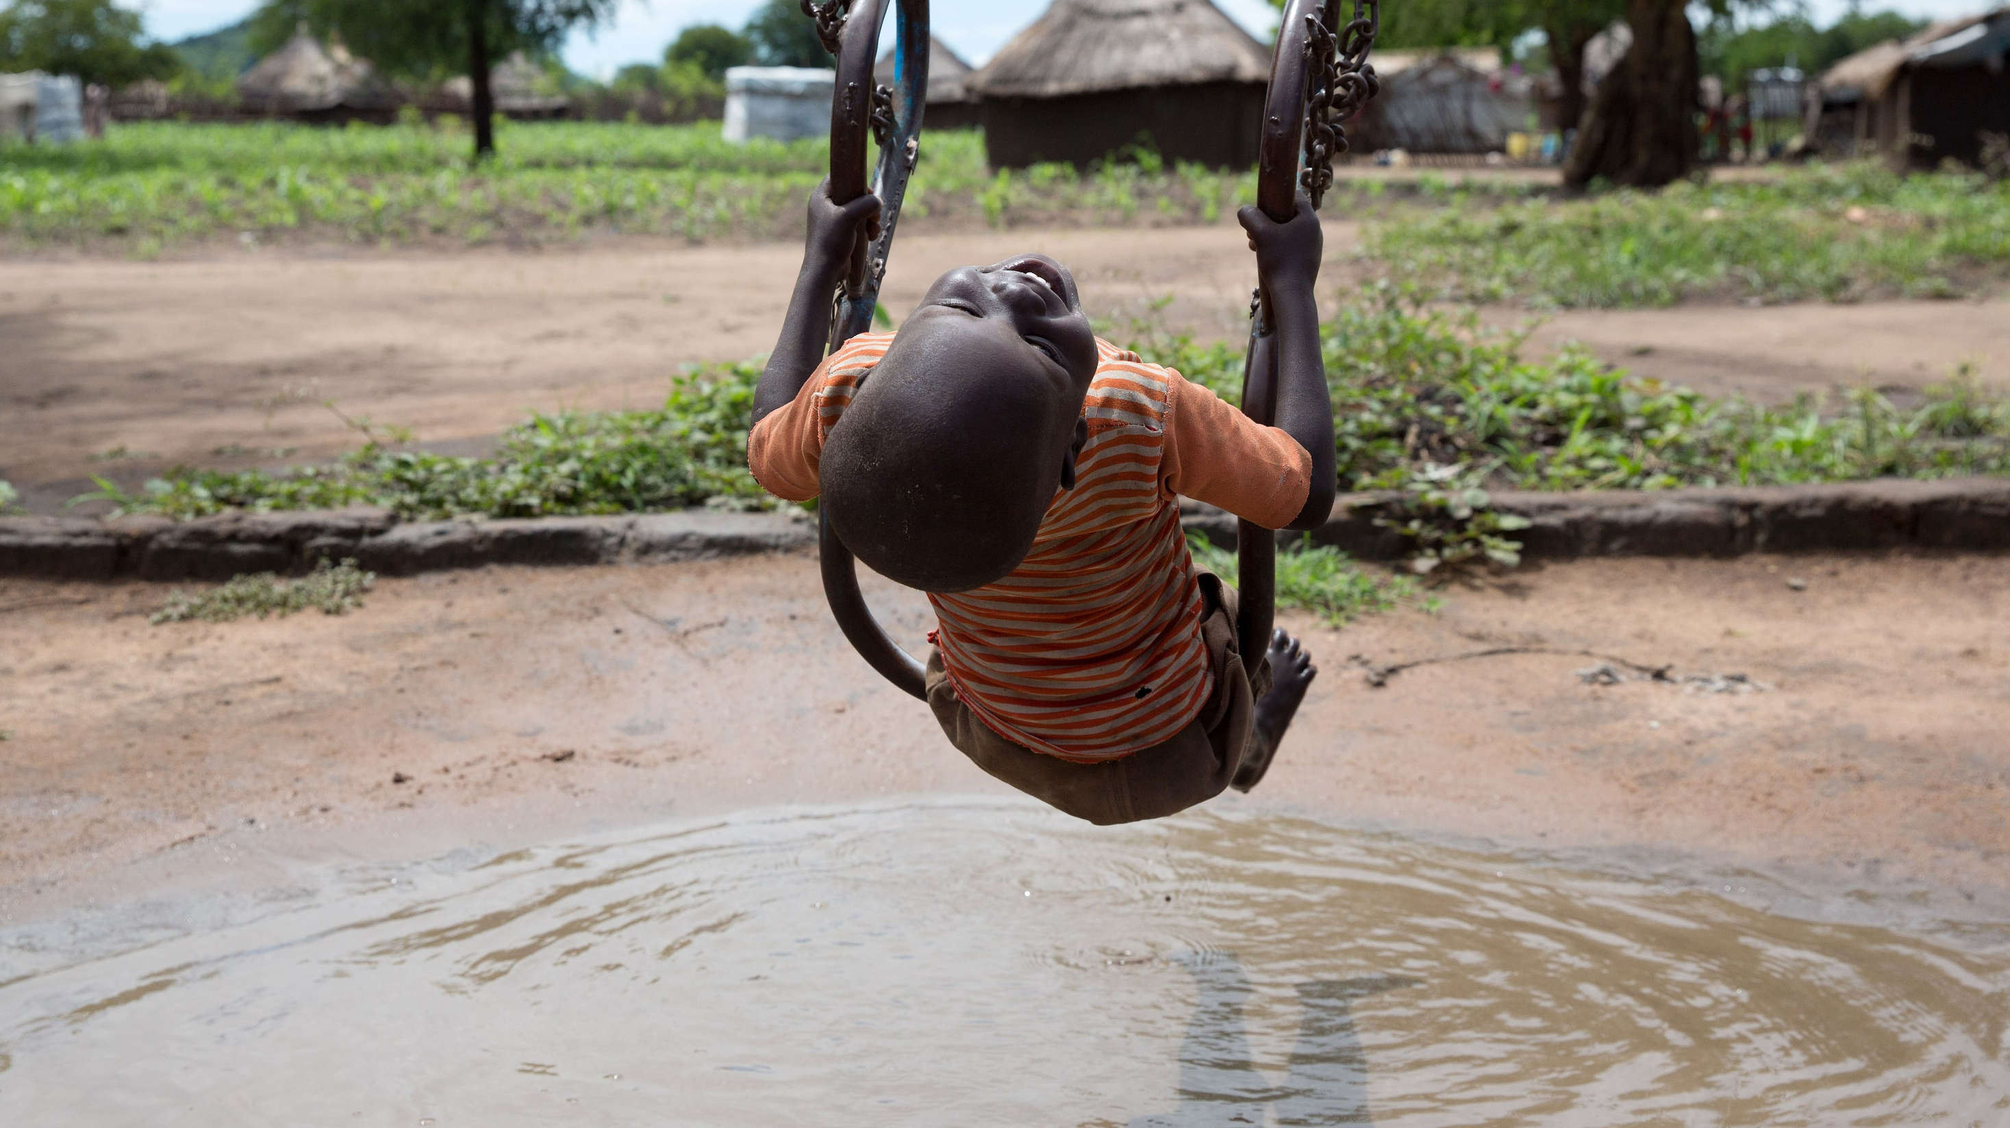
THANK YOU!

